Slide 1
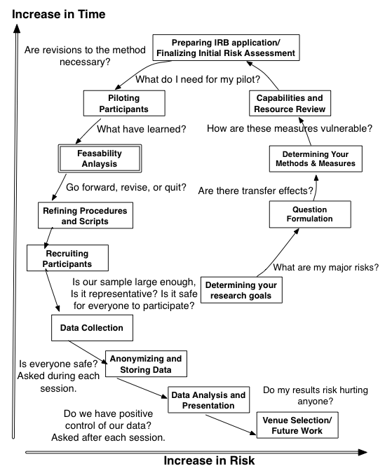
A Risk-Driven Approach to Experimental Design and Practice
Presented at the Cognitive Science Conference, July 2020, Toronto, Zoom. 29jul2020
Frank E. Ritter BSEE, PhD C. Psychol.
frank.ritter@psu.edu
ACS Lab, The College of IST, Penn State
Jonathan H. Morgan PhD (slides and book) Duke Sociology jhm18 @duke.edu
Jong W. Kim PhD and Richard Carlson PhD (book) ACS Lab, Penn State || Psychology, Penn State
Supported by ONR, Contracts N00014-11-1-0275, N00014-10-1-0401, & W911QY-07-01-0004
Notes:
Affects science as a way to do science, and we (often) need more than legal requirements

Slide 2

If you will teach this or want to know more….
Full book available from Sage [paper & PDF]
Slides available as ppt or pdf (email us, or see RBS site)
Tech report available as shorter version http://acs.ist.psu.edu/reports/ritterKM09.pdf
Workbook and other resources available at http://frankritter.com/rbs

Slide 3
Overview  acs.ist.psu.edu/papers
1200-1215 (0) 3 Orientation
1215-1250 (1) 4-10 An overview of risk-driven experimental design
1250-1310 (2) 11-14 Preparation for running an experiment
1310-1330 [20 min. break]
1330-1350 (3) 15-21 Ethical challenges in the experimental process
1350-1415 (4) 22 Risks to validity, with class participation
1415-1435 [20 min. break]
1435-1450 (5) 23-24 Running a session
1450-1505 (6) 25-27 Concluding an experiment, reporting results
1505-1540 (7) 28 Concluding comments and questions
1540-1560 Slack (running online? A recent update)
Notes:
If you would like to share your name and contact details, put them in the chat.

Slide 4
What to get out of this Tutorial
1) Some feeling for how to run a study
Cognitive science may be modeling + data So, to use data you have to know how it was gathered
Modeling is slow, so data publication helps modelers
If you are a computer scientist/engineer, you won’t have taste in this area => Help you develop a green thumb for HCI/HF usability studies
Not how to design a study, but related
2) Some tools to help you set up a study
3) Materials
Book (Sage) and draft book (tech report) [please let me know if you use it for a class!]
Example problems, slides, book has exam questions
4) A greater appreciation for mistakes to avoid and a theory of how to avoid them, and thus problems in studies

Slide 5
Who are you?
1) We will put you into breakout rooms in pairs for intro, learning Zoom, and later exercise (use breakout room for 3 min.), any questions first?
2) Talk about: Name, organization, background, number of studies, what you want to get from this
3) 20 sec. Intro (timed): name, where, interest, question (or chat us the question)
4) We will use stack process for chat questions

Slide 6
Summary 1 of tutorial: (Re)Looking at failure: What constitutes a failure/risk?
Someone got hurt
After committing significant resources, the study was never completed
We have learned nothing new because our data is not repeatable or generalizable
We have failed to communicate our results or their significance to anyone else

Slide 7
Ch 1. Overview Some Terms used (09:10)
A study, varying an Independent variable (IV, e.g., amount of practice), to see the effect on a dependent variable (DV), such as response time
- Worth reading a methods book(s) (e.g., Ray; Calfe)
Subjects (Ss) or Participants (Ps), Users, learners, students, Experimenters (Es)
See APA manual and also Roediger (2006) for arguments for S and P and E/L/S
Example studies in the book:
Multi-lingual fonts
Partially sighted and blind users
Human-robot interaction (HRI)
Notes:
Note what icons mean

Slide 8
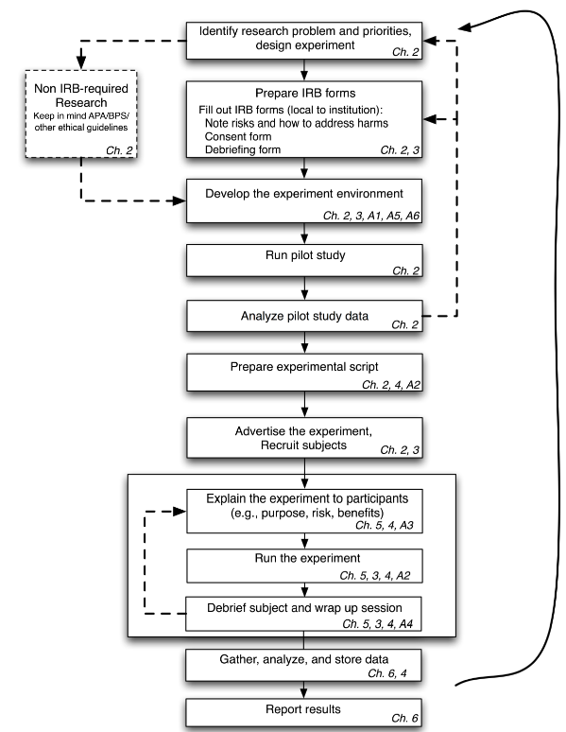
1. Experimental Process Overview, linear
An iterative, and often over-lapping set of process steps
Notes:
Note use of chapters in book, note and pull up the tech report

Slide 9
Experimental Process Overview Risk Driven, more spiral

Slide 10
Summary: Lessons so Far
More steps than I thought
Iterative and risk-driven (if you pay attention)
A process but not a set process
Studies will overlap each other and inspire each other
It is useful to have the RAs/Es pay attention
Ss suddenly ‘get it’
Ss don’t get some aspect
Ss comments
Ss ‘cheat’ somehow
Notes:
Note that this process is all compressed in the study report, we created a task…. Which took 5 iterations and 4 failures…

Slide 11
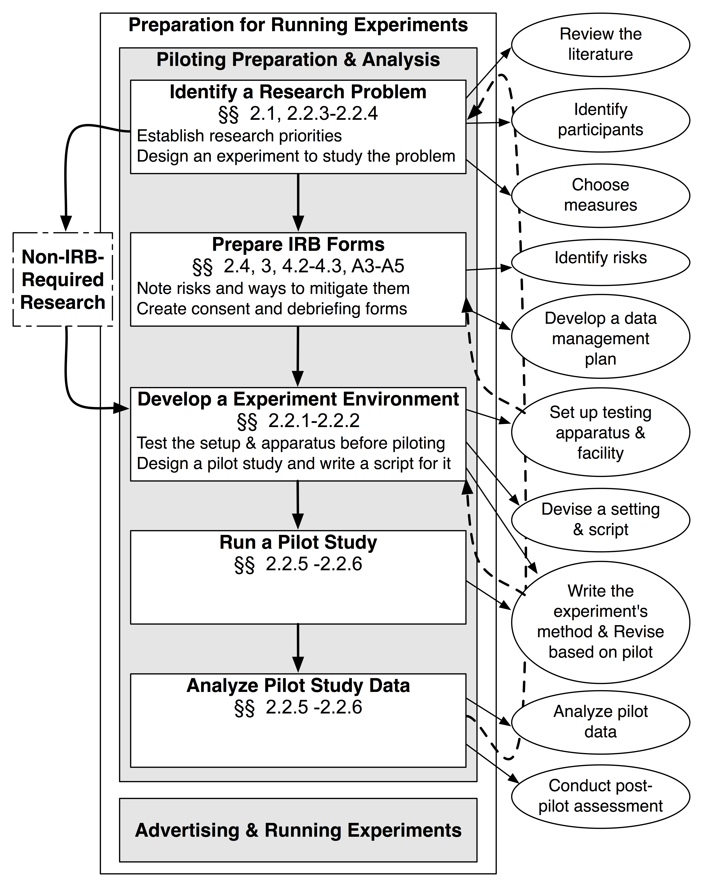
2. Preparation for an experiment (12:50-13:10)
Experiments are driven by their questions and shaped by the methods available to explore those questions and existing results/lessons in that area
Notes:
Formal Experiment, Controlled Observation, Naturalistic Studies, make distinctions in the slides. Wordings effects on behavior should be noted in slides.

Slide 12
What studies need IRB?
In the US
If not publishing or class projects, no IRB (but, be careful)
If only authors are Ss, no IRB
If only published / publicly available data, no IRB but IRB has to ok this (!)
Else: IRB
Blood, sexual history, etc. are high-risk,=> full IRB
Outside US
Depends, UK used to do IRB only on high-risk studies
Can you tell me?
BUT, in all cases, worth having someone check your work

Slide 13
IRB Forms
Used to check your work
Can be a draft method section for papers
May be worth being clear and concise
Also check with example forms for language
Draft for the Principle investigator (PI)

Slide 14
Summary: Piloting
New: Check the literature further
New: Check other data sources, e.g., your lab, respositories like Databrary.org
Write out method
Used to check your work by you and others
Use a script, Step 1, start program XXX on disk YYY, Step 2 “Welcome to…”
Start local, e.g., You, and then officemate, and then move further and further away
Mount a scratch monkey
Check your apparatus and data gathering and use of data
Consider/reconsider, number of Ss to run
Previous studies
Power analyses (Cohen for Ss; Ritter et al. (2011) for models)
Why not prefer large effects?
New: check your pilot data with analysis (linear, non-linear so take more points?)
New: and with target stat programs, see it loads, etc.

Slide 15
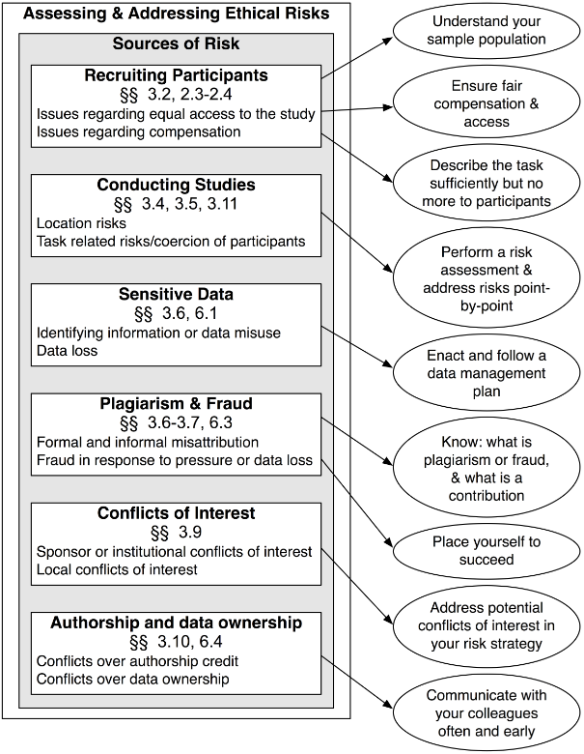
3. Ethical Challenges Associated with the Experimental Process (13:10-13:30 break) (13:30-1350)
Ethical problems can be decreased by deliberate proactive action.
A couple of bad examples and then a general view

Slide 16
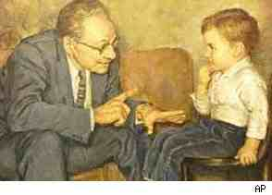
The Monster Study: Wendell Johnson’s Stuttering Study (1939)
Evaluated the effect of external valuations on stuttering
interupting vs. non-interupting conditions
Studied 22 orphans ranging in age from 5-15 years old, grouping them into 5 fluency categories
Resulted in long-term developmental and psychological harm, with $925,000 awarded to six of the participants in 2007
Avoid manipulations that can harm people

Slide 17
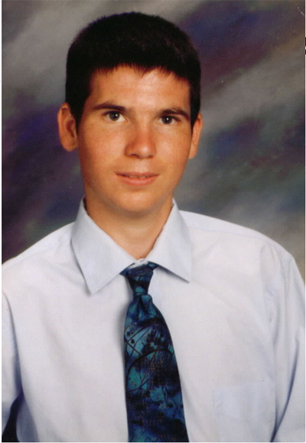
Jesse Gelsinger (1981-1999)
Included in a bio-medical intervention study to replace a missing participant despite testing positive for high ammonia levels
The informed consent agreement failed to disclose either known adverse drug effects or the death of two monkeys in animal trials.
A profound conflict-of-interest existed
Avoid conflict of interests
Cases like this give rise to the need for IRBs

Slide 18
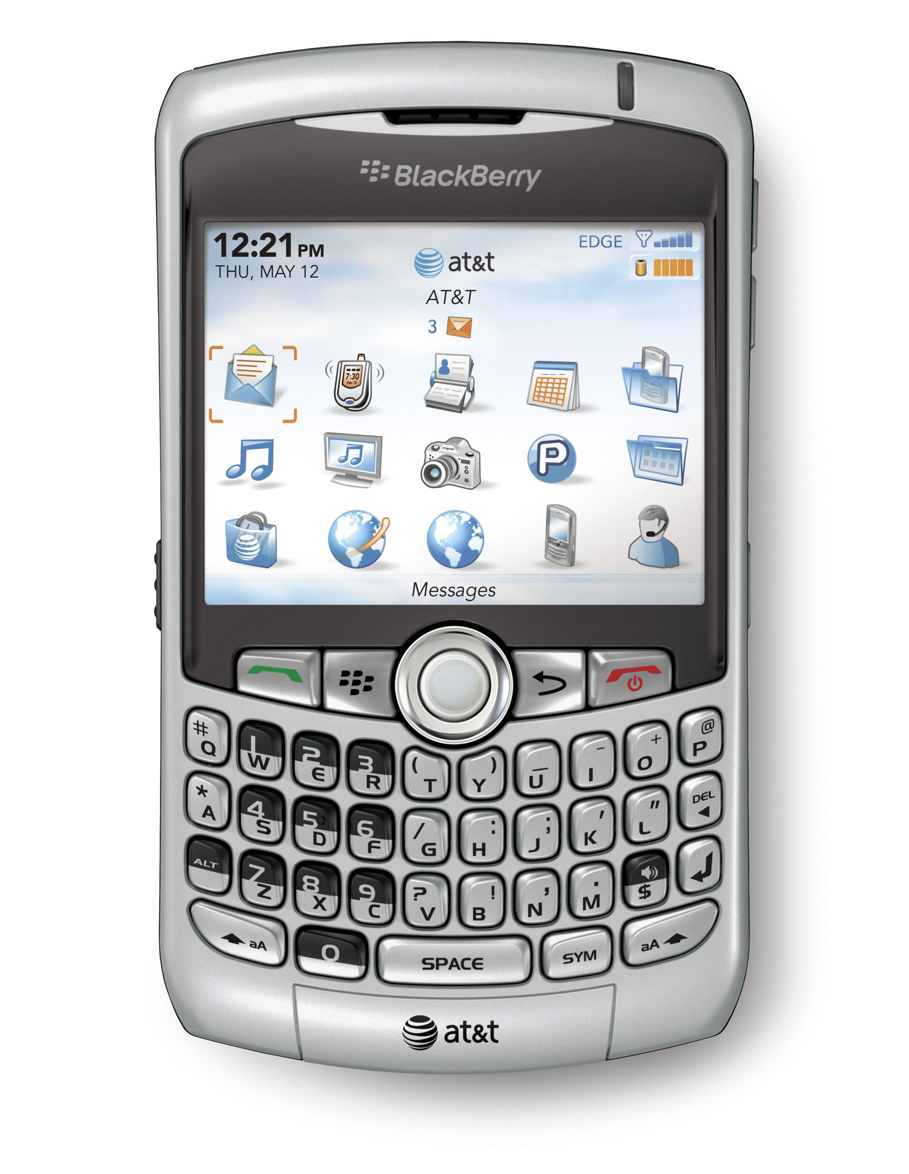
A HCI Study Gone Wrong (circa 2008)
No informed consent
No privacy grantees or data management plan
“You have no friends.” Yes, a student researcher felt compelled to inform a participant and the S’s teachers and the Dean of this fact.

Slide 19
Ethical Challenges Associated with the Experimental Process (13:30-1350)
Ethical problems can be decreased by deliberate proactive action.

Slide 20
Exercise: Two ethical dilemmas [iff time]
A. In screening candidates for a stress study, you discover one of your P’s heart rate suggests a medical condition. (or, in any study situation, a subject arrives in an altered state.) Do you have an ethical obligation to report this to them?
B. In collaboration with Dept. of Veterans Affairs, you & your team are evaluating long term a learning theory and a tutor based on that theory where some learners have PTSD. As the study progresses, many of the learners experience significant personal hardship and prolonged unemployment. Does this change in status present an ethical challenge with regards to the participants’ freedom of consent? If so, does the veterans’ right to participate and their self-felt obligation to help, and their increasing interest in the payments, outweigh this potential threat to consent? Also, what if the nature of the content knowledge (e.g., battlefield first-aid) interacts badly with their PTSD?

Slide 21
Summary: How to avoid ethical problems
Recruit fairly
Look out for your Ss
Anonymise data at the beginning of each session by using subject IDs, not names
New: Only take data you need
New: Be aware of deductive closure
Have a plan for surprising data or situations (e.g., high BP, contact senior RA, PI, IRB Office, 911)
Communicate early and relatively often about publication plans and data ownership
Some argue that you have an obligation to use the data you gather

Slide 22
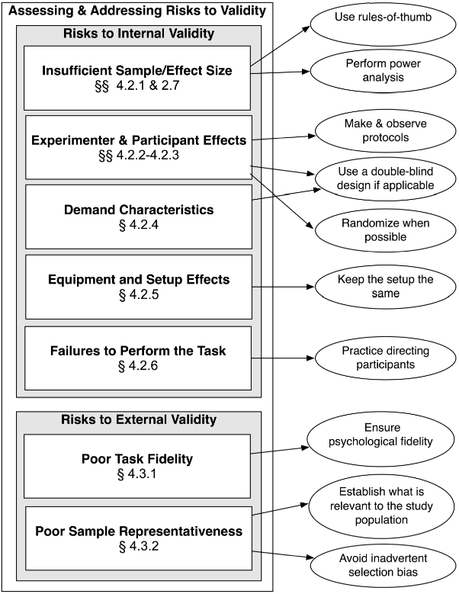
4. Risks to Validity: Constraints on your study (13:50-14:15) Or: alternative hypothesis for results
Challenges to validity can be anticipated and mitigated.

Slide 23
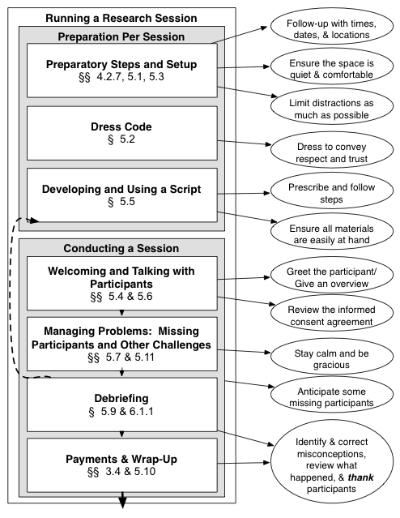
(5) Running a Session (14:35-14:50) (14:15-14:35 break)
Success in execution is directly correlated to careful preparation
Notes:
I thought this tutorial was about how to run a study, and you only spent 15 min on that topic!

Slide 24
Summary: Running a session
Use of piloting means no surprises (except for the data!)
Script keeps treatment the same, it includes session set up
New: Assignment needs to be random
Not a sample of convenience
Needs to not pick up: time of day, week, month, semester, cohort, age, etc.
Use cards, coins, SPSS, spreadsheet to randomize
We just don’t use Ps who cannot make the long session
We assign PC and Mac equally to the 9 groups
Keep eyes open while running for further insights
Anonymise data as soon as possible

Slide 25
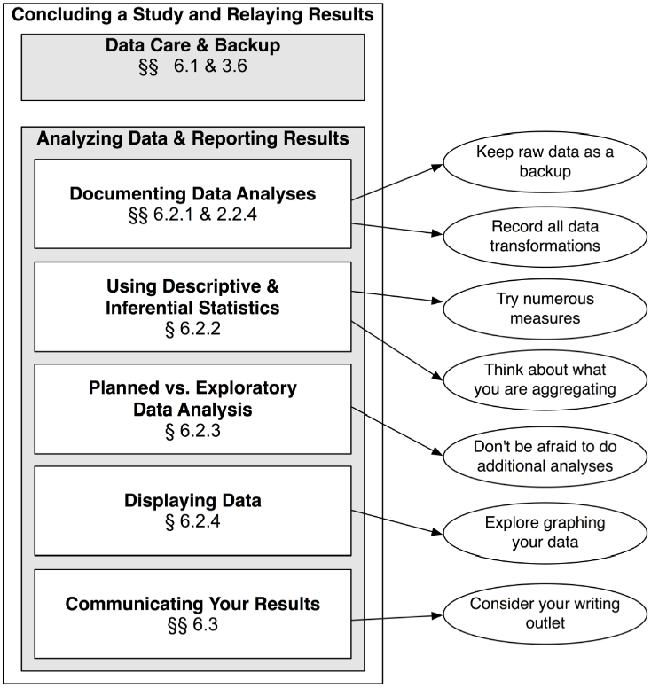
(6) Concluding an Experiment and Reporting Your Results (14:50-15:05)
Debrief subjects,
Debrief each other,
Debrief potential audience!

Slide 26
Summary: Concluding an Experiment and Reporting Your Results
Concluding a session
Finish with the subject (thank, debrief, check paperwork)
Check the data was collected and saved
Comment on the data if anomolies
Data care, security and privacy
Anonymizing removes nearly all ills
Back up data (daily, weekly)
Data analysis
Not how, but note how (document and keep track of)
Know your data if you are the RA that analyses
Save the analyses, time is not important, space is not important, the insights and results are important
Aside: we prefer regression
Aside: we prefer individual analysis

Slide 27
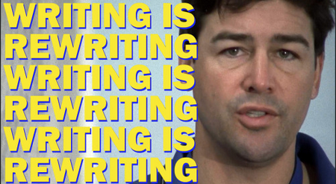
Ch 6.5 Communicating your results
Start with a target in mind (if you can)
Work to larger publications (workshop, conf, journal, book)
Rewrite, rewrite, rewrite (the book was draft 49 [mar12], final 53)
Academic Coach Taylor

Slide 28
Running KRK Online Sarah Ricupero & Frank E. Ritter 29jul2020
IRB/protocol changes, cover online condition (keep conditions balanced)
Scheduling the 2-5 sessions was with email, XL, box (shared cloud document)
Tool choice varies based on Subject numbers, number of potential recruits, length of sessions, length of task, complexity of conditions, repeated sessions and their regularity
hroot (that's what we use), orsee (inspiration for hroot)
hroot: https://www.wiso.uni-hamburg.de/en/forschung/forschungslabor/experimentallabor/hroot.html
orsee: http://www.orsee.org/web/
Recruitment
No: handouts, speaking in class
Yes: “Who can we email?” course instructors, other labs, social organizations, grad-student-list@psu.edu, facebook, linkedIn
Payment
No: Cash doesn’t work
Yes: gift cards (Amazon), University cash
Running the study
Required: computer, camera, microphone, paper, pencil, email, internet
Zoom (provided by university, Adobe Connect, MS Teams), webcam, microphone
Changes: modify S’s browser to turn-off autocomplete, ask them to clear their space
Use email to arrange
Use a web-based apparatus, or download and then delete
Does not work if ms timing required, unless they download keystroke logger (e.g., RUI)
Short tasks, try Amazon MT (https://www.prolific.co/)
Should include: displays (matters), type of machine (matters), type of mouse (matters)
Also see: http://sll.stanford.edu/docs/Webinar_materials_v2.pdf
It helps that people are at home and sheltering-in-place, essentially, less general movement less activity

Slide 29
7 Concluding Comments/Afterword 15:05-15:40
Appropriate behavior with subjects
Insights
Repeatability
Reportability
Questions/Discussion

Slide 30
Summary 1 of tutorial: Relooking at failure: What constitutes a failure?
Someone got hurt.
After committing significant resources, the study was never completed.
We have learned nothing new because our data is not repeatable or generalizable.
We have failed to communicate our results or their significance to anyone else.

Slide 31
Sources of Failure?
Why did someone get hurt?
We failed to do a risk assessment.
Being prepared for unanticipated problems.
We failed to screen participants properly.
We failed to either develop or follow procedures, either experimental procedures or data management procedures.
We did not anticipate or mitigate situational risks either in our experimental setting or outside of it that hurt our participants.
We ignored additional insights we could have learned from the participants through observation or debriefing.
New: deductive disclosure, enough to identify someone. Male, US citizen, IST professor (there are three in the world)
Others?

Slide 32
Sources of Failure?
Why we were unable to complete the study?
We were overly ambitious, perhaps because we failed to fit the research question or methods to the problem at hand.
We ran out of time.
We ran out of resources or lacked them in the first place.
We lacked the people, either participants or staff, or trained staff.
(experiments appear to have less risk than modeling)

Slide 33
Sources of Failure?
Why we were unable to reproduce our results or generalize them?
We failed to use the same experimental procedures or test under the same conditions for each S.
We failed to achieve an adequate sample size or sufficient degree of representativeness in our sample.
Our task fidelity was poor. We failed to construct an experimental task that was analogous with respect to its key points.

Slide 34
Sources of Failure?
Why have we been unable to report our results or communicate their significance?
We failed to properly catalog or backup our data.
We failed to write as we went. We no longer remember some of the critical, early details.
We made poor data analysis or display choices.
We failed to identify a venue early, or understand who we should consider our audience.

Slide 35
How do we avoid failure?
We recognize that running a study is an incremental risk-driven process, similar in some respects to spiral development of systems (Boehm & Hansen, 2001; Pew & Mavor, 2007).
To be successful, we need to:
Formulate a research question that meets our research goals
Have a theory of transfer effects that minimizes risks associated with confounding variables, and enables us to conserve time and resources
Pilot studies and study components
Be candid in our risk assessments and be willing to adapt and refine

Slide 36
Summary 2 of Tutorial
There are steps to running a study separate from design and analysis
These steps include practical, hands-on, implicit and local knowledge
They are informed by previous studies
To be successful, we need to:
Formulate a research question that meets our research goals
Pilot studies and study components
Be candid in our risk assessments and be willing to adapt and refine
Be aware of alternative hypotheses, and avoid what we can and control what we cannot avoid
Plan for reporting results early

Slide 37
Adjustments for Models as Ss
Document and freeze the model
Document and annotate its trace/predictions
Run the model until you have predictions, not samples of predictions (Ritter et al., 2011)

Slide 38
If you will teach this or want to know more….
Full book available from Sage [paper & PDF]
Slides available as ppt or pdf (email us or see RBS site)
Tech report available as shorter version http://acs.ist.psu.edu/reports/ritterKM09.pdf
Workbook and other resources available http://frankritter.com/rbs

Slide 39
7 Concluding Comments/Afterword 15:05-15:40
Appropriate behavior with subjects
Insights
Repeatability
Reportability
Questions/Discussion

Slide 40
References  acs.ist.psu.edu/papers
Boehm, B., & Hansen, W. (2001). The Spiral Model as a tool for evolutionary acquisition. Crosstalk: The Journal of Defense Software Engineering, 14(5), 4-11.
Cohen, J. (1992). A power primer. Psychological Bulletin, 112, 155-159.
Calfee, R. C. (1985). Experimental methods in psychology. New York, NY: Holt, Rinehart and Winston.
Pew, R. W., & Mavor, A. S. (Eds.). (2007). Human-system integration in the system development process: A new look. Washington, DC: National Academy Press. http://books.nap.edu/catalog.php?record_id=11893, checked March 2012.
Ray, W. J. (2008). Methods toward a science of behavior and experience (9th Edition ed.). Belmont, CA: Wadsworth Publishing.
 Ritter, F. E., Kim, J. W., & Morgan, J. H. (2010). Running behavioral experiments with human participants: A practical guide (Tech. Report No. ACS 2005-2). Applied Cognitive Science Lab, School of Information Sciences and Technology, Penn State. acs.ist.psu.edu/reports/ritterKM09.pdf.
Ritter, F. E., Kim, J. W., Morgan, J. H., & Carlson, R. A. (2013). How to run experiments: A practical guide to research with human participants. Thousand Oaks, CA: Sage. http://www.frankritter.com/rbs
 Ritter, F. E., Schoelles, M. J., Quigley, K. S., & Klein, L. C. (2011). Determining the number of model runs: Treating cognitive models as theories by not sampling their behavior. In L. Rothrock & S. Narayanan (Eds.), Human-in-the-loop simulations: Methods and practice (pp. 97-116). London: Springer-Verlag.
Roediger, R. (2004). What should they be called? APS Observer, 17(4), 5, 46-48. Online: www.psychologicalscience.org/observer/getArticle.cfm?id=1549.
Winston, A. S. (1990). Robert Sessions Woodworth and the "Columbia Bible": How the psychological experiment was redefined. The American Journal of Psychology, 103(3), 391-401.

