Slide 1
Human Factors Engineering
BME 6086 / BME 4985
Jeffrey Bolkhovsky, Naval Submarine Medical Research Laboratory, University of Connecticut
Jeffrey.Bolkhovsky@uconn.edu
Spring 2019

Slide 2
Errors
Human error is a large subject – this is an overview
Errors are inherent to systems that involve humans
Goal is to highlight relationship between system performance and errors
Identify the situations that lead to erroneous performance
Choose appropriate mechanisms to prevent or mitigate
Errors are due to MORE than error-proneness or maliciousness

Slide 3
What is an Error
Errors are generally regarded to as accidents
Trigger sets of events
Severity linked to consequence
Causes outcomes that involve loss of life/money/machinery

Slide 4
Fault-Error-Failure Model
Failure: Service has been judged to have deviated from its specifications
Error: System state that leads to subsequent failure
Fault: Cause of the error
Creates chains of failure-error-fault triplets
A failure in one system may be the fault of another

Slide 5
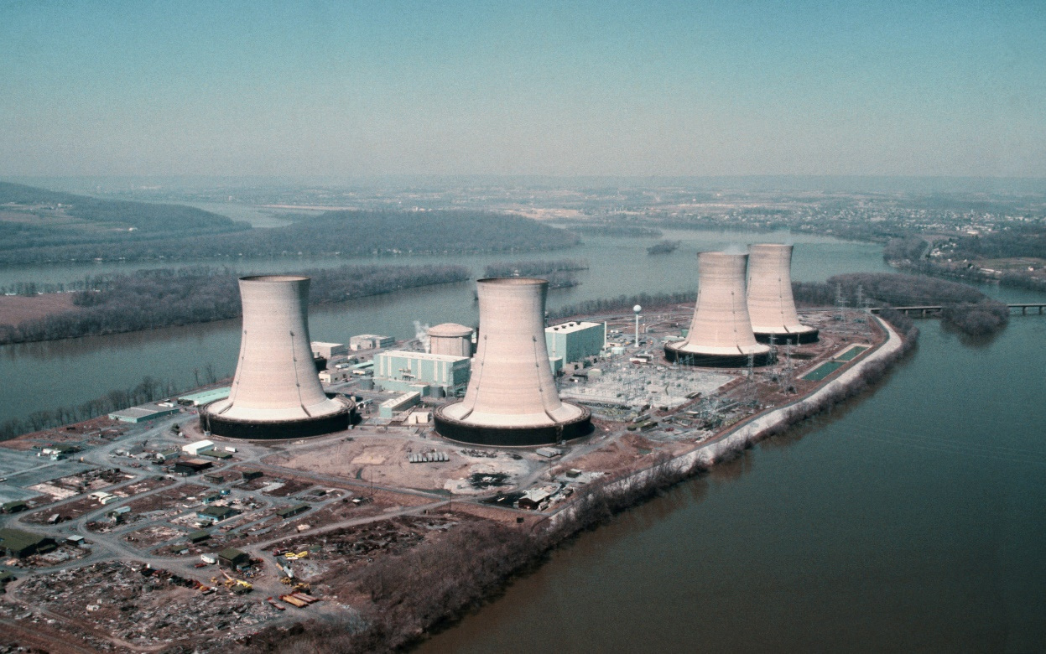
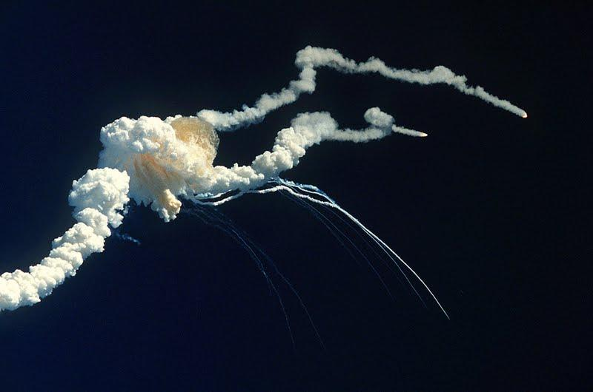
Types of Errors
Immediate Errors or Active Errors
Latent Errors – can lie dormant for considerable time
Notes:
The commission that investigated the nuclear accident at Three Mile Island, for
example, found that an error that had occurred during maintenance (and hence was
latent in the system) led to the emergency feed water system being unavailable
(Kemeny (chairman) 1979).
Similarly, the vulnerability of the O-ring seals on the
Challenger Space Shuttle was known about beforehand and hence latent in the
system (Vaughan 1997). The vulnerability was only exploited after the decision
was made to launch the shuttle in very cold weather.
****It is important to learn from errors, things WILL go wrong, prevent repeat performance*

Slide 6
Human Error
Human error is the cause of the event or action. An example of this would be if an aircraft deviated from its assigned flight altitude to a different flight altitude (either higher or lower than the one that the flight crew had been given by Air Traffic Control) due to the actions of the flight crew.
Human error is the event or action itself. An example of this would be if an aircraft pilot did not change the altimeter setting when they were supposed to. Note that in this case the action is really a deliberate non-action.
Human error is the consequence of the event or action. An example of this would be if an aircraft collided with another aircraft because the pilot started to taxi before receiving clearance to taxi by air traffic control.
Notes:
The problem is that
the term human error is ambiguous and has three subtly different meanings
(Hollnagel 1998), which are often confused by the press. It is therefore worth
spelling out these different meanings, using examples from the field of aviation

Slide 7
Human Error
Context Dependent: People generally do what they think is right.
Many times errors are judged after the fact based on:
  A comparison with some expected level of performance
  A degradation in performance
  The person who performed the act having been unable to choose to act in a way that would not have been considered as erroneous.
One Exception: Violations are usually errors
  But even then there are “safe violations” which are violations made to be safe

Slide 8
Erroneous Actions
Result of :
  Performing the right action in the wrong circumstances. This is what Reason(1990) calls a mistake, or a failure in planning.
  Performing the wrong action in the right circumstances. This is often referred to as a slip (Norman 1981; Reason 1990), or failure in action execution.

Slide 9
Perspectives from which to Identify Errors
Common sense: to explain an unusual event
The lawyer: to find somebody to blame and/or punish
The therapist: to improve human performance
The scientist: to understand human behavior
The reliability analyst: to evaluate human performance
The designer: to improve system configuration.
Notes:
What an error is depends on what you are looking for.

Slide 10
Fine Line Between Success and Failure
‘‘Knowledge and error flow from the same mental sources, only success can tell one from the other……the same mental functions, operating under the same rules, in one case lead to knowledge, and in another, to error….’’

Slide 11
Accidents and Attribution
Accidents often attributed to human error
Usually built on underlying assumptions that don’t capture everything
Assumptions usually based on limitations of causal analysis
Humans can be:
  Constrained by time and pressure
  Limited attention resources
  Caused by too much multitasking
  Caused by distractions
  Limited both psychologically and physiologically

Slide 12
Examples of Errors and Limitations
A plane crashing on take-off because the distracted crew failed to complete a safety checklist that would have confirmed that the aircraft’s flaps had not been extended.
A plane crashing into a river when the co-pilot failed to get the attention of the Captain about concerns that the take-off thrust had not been properly set. The co-pilot felt that he could not tell his superior what to do.
A plane crashing when it ran out of fuel due to a communications breakdown between the Captain, the co-pilot, and air traffic control about the amount of fuel onboard.

Slide 13
Who/What is at fault?
Hard to determine fault.
Final users usually considered cause.
Blunt/Sharp model:
  anything across process/system can be at fault, the sharp end is easier to see can be mistaken
Notes:
If a doctor makes a medication error after having worked
for 24 h continuously, for example, can we really blame the doctor?
Decisions at the regulatory level can affect decisions at the operator level.

Slide 14
Studying Error
Data collection is necessary to study error.
What do you need to ask to collect data?
  Why gather data?
  What sort of data to gather?
  Where (and when) to gather data?
  How much data to gather?
  How to gather data?
Questions cannot be answered in isolation
Erroneous is inherent to human performance.

Slide 15
Laboratory Based Experiments
Independent variables can be experimentally controlled
Lack of Face validity
Does not represent real world
Cannot be generalized
Availability of subject pool
Subject pool biased to systems familiar to them
Subjects can “game” the system
Difficult to represented complexity of real world in lab
Notes:
High fidelity simulators do exist but run the risk of changed behavior due to observation.

Slide 16
Field Based Observation
Data has ecological validity
Relatively low error rate (low rate of data collection)
High costs associated (need to run till you have enough data)
Humans adapt in the field - can detect and recover to mitigate
Presence of observer can affect behavior

Slide 17
Archive Data
Data are real
Ecological Relevance
Large number of observations
Cost of collecting data low
Gathered for a different purpose
Details may not be available and/or validated
Data may be subject to reporter biases
Notes:
HEAP a powerplant simulator comes closest to ideal but even then operators could guess purpose of study and “game system”

Slide 18
Error Taxonomies
Taxonomies help provide a frame of reference to understand your system.
How you analyze will change what level of abstraction you use.
Work at the level that allows remedies to be generated.

Slide 19
Technique for Human Error Rate Prediction (THERP)
Actions can be:
  Correct.
  Errors of omission: actions that are omitted. It may be difficult, however, to determine whether an action has been omitted or has just been delayed for a long time.
  Errors of commission: actions that are performed inadequately, out of sequence, or at the wrong time (too early/late); or are qualitatively incorrect (too much/too little/wrong direction).
  Extraneous actions: actions that would not normally be expected at that particular time and place.

Slide 20
Generic Error Modeling System (Gems)
Errors are:
  Slips (execution failures)
  Lapses (memory storage failures)
  Mistakes (intentional failures)

Slide 21
GEMS
Notes:
Figure shows the relationship
between the different types of errors in GEMS and a typical stage model of
human information processing.
Reason’s Generic Error Modelling System (GEMS) error types related to a simple
stage model of human information processing (adapted from Wickens and Holland 2000)

Slide 22
Cognitive Readability and Error Analysis Method (CREAM)
No single ideal taxonomy
Defines the interaction between three high level factors:
1. The human operator
2. The technology (usually the system being operated by the human)
3. The wider organization (including the environment in which the system islocated).

Slide 23
CREAM: Human Error Manifestations
Timing: the action is too early/too late/omitted.
Duration: the action is too long/too short.
Force: the action uses too much/too little force.
Distance: the action is carried on too far/too short.
Speed: the action is too fast/too slow.
Direction: the action is performed in the wrong direction or involves the wrong type of movement.
Object: the action was carried out on a proximal object/similar object/unrelated object rather than the required object.
Sequence: in a sequence of actions there was an omission/skip forward/skip backward/repetition/reversal or the wrong action was performed.

Slide 24
Analyzing Errors: Event Trees
Notes:
Example quantification of event tree for a building protected by a sprinkler system
(reproduced with permission from the Institution for Engineering and Technology)
Bottom-up technique for analyzing errors

Slide 25
Analyzing Errors: Fault Trees
Notes:
generated in a top down
(deductive) manner, starting with the outcome and working backwards in time to
try to find all the things that could have caused that particular outcome.
A quantified fault tree showing the likelihood of a crash occurring at a given road
junction (reproduced with permission from the Institution for Engineering and Technology)

Slide 26
Analyzing Errors: CREAM

Slide 27
Analyzing Errors: Technique for Human Error Assessment (THEA)
Notes:
Higher level influences on human performance
Iterations take place at a higher level
IP = Information Processing

Slide 28
Implications
Consider interdependencies
Atomic decomposition may be inappropriate
Identify what a system should do and what is a consequence of error
Understand that people have psychological and physical limitations
Allocate work appropriately
Provide feedback
Allow practice

Slide 29
Exercise
Notes:
Redraw the event tree, for errors when entering a purchase on a
smartphone or other mobile device. You can make (and may need to make)
assumptions about the application and about people. Note these assumptions,
and note briefly what studies or references you would need to read to find out
more accurate answers.

Slide 30
Activity
Redraw the event tree for another process. (e.g., making a purchase on a smartphone)

Slide 31
Tools and Concept: Task Analysis

Slide 32
Task Analysis

Slide 33
Cognitive Dimensions: Language for Design

Slide 34
Examples of Unique “Presentations”
https://www.youtube.com/watch?v=Yocja_N5s1I&list=PLBDA2E52FB1EF80C9

