Slide 1
Human Factors Engineering
BME 6086 / BME 4985
Jeffrey Bolkhovsky, Naval Submarine Medical Research Laboratory, University of Connecticut
Jeffrey.Bolkhovsky@uconn.edu
Spring 2019

Slide 2
The ABCs of Users
Anthropomorphic
Behavior
Cognition
Social
Notes:
Anthropometrics: the shape of the body and how it influences what is
designed; consideration of the physical characteristics of intended users such
as what size they are, what muscle strength they have, and so on
Behavior: perceptual and motivational characteristics, looking at what people
can perceive and why they do what they do
Cognition: learning, attention, and other aspects of cognition and how these
processes influence design; users defined by how they think and what they
know and what knowledge they can acquire
Social factors: how groups of users behave, and how to support them through
design; users defined by where they are—their context broadly defined
including their relationships to other people.

Slide 3
Social Cognition and Teamwork
All work is carried out in a social construct
Most places are socio-technical systems
  Interdependency between social and technical
Potential Groups Working Include:
  Individuals
  Dyads (two people)
  Groups
  Teams
  Communities
Notes:
Team: Two or more individuals to carry out work
Team depends where you draw the boundaries
Aviation example:
Cockpit, aircraft, ground crew, air traffic control, airport.

Slide 4
What is a Team (Recap)?
Two or more individuals to carry out work.
Depends where you draw the boundaries
Example: Aviation
  Cockpit
  Crew
  Airplane
  Tarmak (Ground Crew)
  Airport
Distributed in space and time
Change dynamically

Slide 5
Social Effects of Decision Making
What factors influence team dynamics?
What factors influence and affect team performance?
What social factors influence teams and communities?
What biases arise due to team behavior?
Notes:
In this section we are covering

Slide 6


Slide 7
Diffusion of Social Responsivility
Diffusion of Social Responsibility
  When one person chooses not
  to do anything thinking that others will
  Effected by relationships between individual and affecter
  Individually asked to be help accountable or not
  Consequences
To avoid
  Target individuals
  Use names in communications
  Note consequences
  Be specific
Notes:
This figure, which appeared in a pre-game (American football)
newspaper program, ran for 3 weeks (with different
opponents appropriately inserted), with the labels
‘‘When Penn State has the Ball’’ for its defensive team and for its offensive team
Darley and Batson (1973) had theological seminary (i.e., religious
professional) students prepare a talk and then walk individually to the next
building where they were supposed to give their talk to a panel. Some students
prepared a talk on the tale of the Good Samaritan (a biblical story about a man who
stopped and helped an injured man) and some prepared a talk on a topic that did
not involve helping others. Some of the students were told to hurry to the next
building because they were late, some were told they were somewhat late, and
some had more time to make the trip. On the way to the next building each student
passed a person slumped in a doorway. Unknown to the students, this person was a
confederate of the experimenter. Data was collected on who stopped to help this
person, and how much help they offered.
The students who had the most time to get to the next building helped the most
(63%); those in the greatest hurry helped the least (10%). The students who were
somewhat late helped 45% of the time. Ironically, the amount of help they gave
was not influenced by whether the student was going to give a talk on the Good
Samaritan or not.

Slide 8
Social Effects
Pluralistic Ignorance
  Base your interpretations of a situation off of others
  Make assumptions about other’s behaviors
  If an event is ignored, evidence may suggest you ignore too
  Occurs when the observer has to interpret before responding

Slide 9


Slide 10
Fundamental Attribution Error
Self Versus Others
  We give ourselves credit based on internal capabilities
  Blame environment or others on our failures
  Attribute other’s success to their environment
  Failures to their personal deficiencies
For bad occurrences we:
  Explain in a way that distances the situation from our circumstances
  To distance ourselves from the thought it could happen to us

Slide 11
Attribution Errors in Design
Designers
  attribute own needs
  Believe users are like them
  Thing users behave in same manner
To Fix
  Differentiate needs of self from user
  Transparent systems
  Make appropriate attribution: error with device or self action?

Slide 12
Notes:
Ritter has personally seen the following ways that email has been lost, misfiled,
misdirected, or lost. Are these errors? In some ways they are. Are they the fault of
the user or of the system or the system designer? It seems to vary. In all cases, the
sender might want a response.

Slide 14
Cognitive Dissonance
When a user holds two conflicting beliefs
People will rationalize their choice
Will be convinced they are in the best position
Notes:
The fox reasoned that the grapes that he could not reach were sour, and
hence not worth getting. People sometimes adopt a similar line of reasoning when
they do not get the rewards they were expecting (such as a promotion to a new
post) by convincing themselves that they are currently in the best position.

Slide 15
Majority and Minority Effects
Behavior Changes in Groups
Group thing: shifting to majority view
Risky shift: group makes riskier decision than an individual
  Emotional bonds decrease anxiety and risk is perceived as shared
Cautious shift: groups move to conservative position

Slide 16
Factors that affect Team Performance
Notes:
Factors that affect performance
KNOWLEDGE
SKLLS
ATTRIBUTES

Slide 17
Notes:
Social Factors affecting team performance

Slide 18
Team Competency
Align team members
  Task goals
  Individuals moving towards goals
Multidisciplinary
  Diverse skill set (if necessary)
  Covers more areas
  Align competency with tasks
Occasionally limited by worst member
Coordination > Speed or Talent
Notes:
Baton running: team affected by “weakest line”
Coordination is frequently more important that speed or talent, doesn’t matter how fast you go if you aren’t going in the same direction.
That’s not to discount speed or talent, but without coordination you accomplish nothing.

Slide 19
Team Communication
Need communication to form a structure
  Support communication
  Support information sharing
Ways communication can influence development
  Bringing new people up to speed
  Increase in communication overhead
Things that can increase communication
  Higher psychological link (friends)
  Psychological similarity (attitudes, values, beliefs)
  Pursuit of common objectives

Slide 20
Social Distance
Notes:
Social distance, a concept introduced by Park (1924), refers to the distance in
social terms between two groups or between people.
More recently, social distance has come to be regarded as a continuum rather
than discrete levels, stretching from an in-group bias—people just like me—to an
out-group bias—people not at all like me (Eveland et al. 1999; Perloff 1993).
Nevertheless,
the concept of a social distance continuum is a useful way of capturing
the influence of culture, particularly as it relates to the development of out-group
biases.

Slide 21
Spatial Distance
Encompasses both geographical and temporal distance
Larger distance needs more coordination and planning.
Large Spatial Distance can:
  Distort sense of accountability
  Decrease attachment to goals
  Decrease participation
Notes:
Encompasses geographical and temporal
Geo: people that work by phone or email
Temporal: people that work in shifts (one group ends as another starts)
Combination: Distance which is exacerbated by time zones.

Slide 22
Mutual Support and Surveillance
Relationships between team members impact performance
Two types: peer to peer and subordinate-superior
Change in relationships affect outcomes
Good Team/Group Relationships Bring
  Sense of identity (part of a group)
  Guidelines for ambiguous/chaotic situations
  Predict actions of others
  Moderate stress (buffering members from events)
  Regulate behavior
  Tasks are more likely seen as challenging rather than threatening
  Rapid response for approval OR disapproval
  Constant comparative surveillance

Slide 23

Notes:
Authority
Milgram Experiments
Team leaders are frequently expected to exert authority as part of their roles.
Effects of authority are complex, and frequently cause diffusion of accountability as well.

Slide 24
Task Attractiveness and Authority
Obedience of authority depends on multiple factors:
  Cause
  Benefit
  Legitimate goals
More legitimate goals lead to greater participation
Illegitimate goals lead to a degradation of authority
Can be improved by:
  Making clear goals
  Make payoff direct and immediate
Notes:
Online systems,
including computer games, can be designed to take advantage of this. Carma
(http://www.car.ma), for example, is an online car ride sharing site
The success of Carma’s system appears to be more dependent on social factors
than on technology. (the point is goals are not always financial)
The attractiveness is not there in more rural communities
Social ratings are rewards, worth more in denser areas. bb

Slide 25
Methods for Bolstering Teams
Make communities smaller (reduce network size)
For widespread product create local regions
Choose appropriate social interactions (e.g., title versus no title)
Increase goal attractiveness where possible
Support communication
Include idea building (e.g., providing ways to brainstorm)
Remove social costs (e.g., anonymize data feedback)
Notes:
Yelp created local regions

Slide 26
Bigger Picture Team Factors
Spend time and effort to understand the social structure
If users have to spend time figuring out how to communicate correctly or use new technologies then it takes away from work
Minimize diffusion of social responsibility (e.g., delegate tasks when appropriate)
Understand motivations and supplement if possible
  Do users have to use it your product? Reduce overhead.
  Do users have to use it? Communicate value.

Slide 27
Notes:
ACTIVITY
List of thing going awry with e-mails.
(a) diffusion of social responsibility
(b) pluralistic ignorance
(c) attribution errors
(d) majority/minority effects.

Slide 28
Social Models
Social Models can be Tracked
  To various levels of abstraction
  Through different types of data
    Monetary transaction
    E-mail
    Searching
Social Models go everywhere from the individual to the world as a whole and everywhere in between.

Slide 29
Informal, Pairwise Analysis
Examines results and regularities in social behaviors
Focuses in examining interactions between pairs
Uses conversation analysis
Incorporate things like:
  Rare for people to talk in full sentences
  People will not always politely wait for others to finish
Provides insights
  How much information do people take before acting
  How much information does a person tend to provide
Notes:
Another insight example: If conversational pauses are 1 second, an interface listening to a person should wait that long but not longer

Slide 30
Exchange cost and Benefit
Interactions come with a cost/benefit/both
Payoffs can be Financial/Social
Problems arise when people pursue individual goals
Keep costs as low as possible (not necessarily minimum)
Keep benefits as high as possible (not necessarily max)
Benefit > Costs
Payoff Matrix can be Helpful

Slide 31
Prisoner Dilemma (PD)
In the Prisoner’s Dilemma, two prisoners have been caught doing something illegal, and can either plead not guilty or plead guilty giving state’s evidence against the other. These two decisions or strategies are usually called cooperate (with the other prisoner) or defect (on the other prisoner). The payoff if the two prisoners cooperate with each other and plead not-guilty is that they both go to prison for 1 year. If one prisoner defects and testifies against the other, they walk free but the other prisoner serves 10 years. If both prisoners defect, they share the full blame and get 8 years each.
Notes:
We will refer to a prisoner’s dilemma or PD as a situation in which people need to make a choice that has cost benefits for them and others.

Slide 32
Prisoner Dilemma Payoff Matrix

Slide 33
Iterations of the PD, Building a Team
Axelrod iterated the PD multiple times
If you defect early your colleague may stop trusting you
If you cooperate longer, opponents may not defect
Promise of cooperation can lead to better behavior
It takes time for people to learn to work together
Strategies evolve over time (and ideally to more cooperation)

Slide 34
Notes:
Axelrod’s Findings
Enlarge shadow: beyond the current iteration
Payoffs: Can change from monetary to social to hierarchical
Teach people to care: payoff matrix, show others, removing attribution
Teach reciprocity: People frequently respond to tit-for-tat even though its not “nice”
Improve recognition: Understand who and what people are dealing with
Cooperation not ALWAYS a good thing: can lead to corruption such as for inspectors, if they are friends with party being inspected.
Supporting teamwork with team goals can lead to social lofting.

Slide 35
Networks
Trackers how actors in a group are associated.
Find leaders or nodes with lots of connection
Shows degrees of difference
Helps understand Dunbar number, maximum number of connections
Helps identify holes, where 2+ cooperating groups are not linked
Notes:
Finding leaders:
Companies target high connection nodes to make their products or videos go viral
Milgram (1967) performed the first experiment.
In this experiment he handed out a folder to be sent to someone the initiating
agent did not know. He recorded how many people the folder passed through
before it reached the target. The results were reported as between two and ten, with
five as the median. The study, while intriguing, is deeply flawed. Most of the
folders were not successfully returned, but we do not really know why.
Dunbar number: What is perhaps most important from a system design point of view is the active
connections. In other words, the connections that are used rather than dormant. If
you think about Facebook, for example, some people will boast about having, say,
352 Facebook friends, but when you analyze how many people they really interact
with, the number is much smaller, by a factor of between 10 and 100. If all of the
Facebook friend connections were active, it would be a full time job for an
individual just to monitor their friend’s ongoing activity.

Slide 36
Organizations
Higher social level than groups
Influence on technology and user interactions (organizational systems)
Network structures can be expanded to cover organizations
Made for large numbers
Frequently use computer support to streamline and standardize
Make standard procedures
  Can be bad if the reality is different than planned process
  People reluctant to tell management process is wrong
  People use shortcuts that they don’t want fixed

Slide 37
Cultural Effects
Large systems tend to have a culture
Without preparation products or policies may:
  Make assumptions that lead to misunderstandings
  Lead to unusable products
  Lead to unsafe systems (e.g., users don’t understand how to use)
Ways to mitigate
  Visit/work with culture
  Include members of the culture
  Pilot test and get feedback

Slide 38
Social Models
Ethynography
  Read about culture
  Observe Culture
  Participate in work
Communities of Practice
  Examine/consider community (even outside of work)
  View community interacts
  Encourage communication

Slide 39
Social Models
Static Models
  Similar to networks
  View connectivity between groups
  See how a far away nodes are
Dynamic Models
  Look at how connections are formed and changed
  Examine formation and changes in group structure
    Orientation
    Testing
    Dependence
    Conflict
    Group cohesion
  Helps understand how groups transition

Slide 40
Soft Systems Methodology
Treats purposeful action as a system
Look at linked activities
Helps develop an understanding of the problem

Slide 41
Rich Pictures
Look at work as a social activity
Focus more on communication
Can take a lot of time and effort
“Light” versions to examine
more specific parts
Notes:
A Rich picture for
the work context in a hospital
neonatal intensive care unit
(adapted from Baxter et al.
2005)

Slide 42
Computational Models
Analytical models start to include logic and equations
Equations for:
  How often people meet
  How often they communicate
Example: Influenza outbreak
  How often people interact
  Chance of transmission
  Impact of medical intervention
Not a complete model
Useful for framing discussion
Help find value in decisions such as closing schools

Slide 43
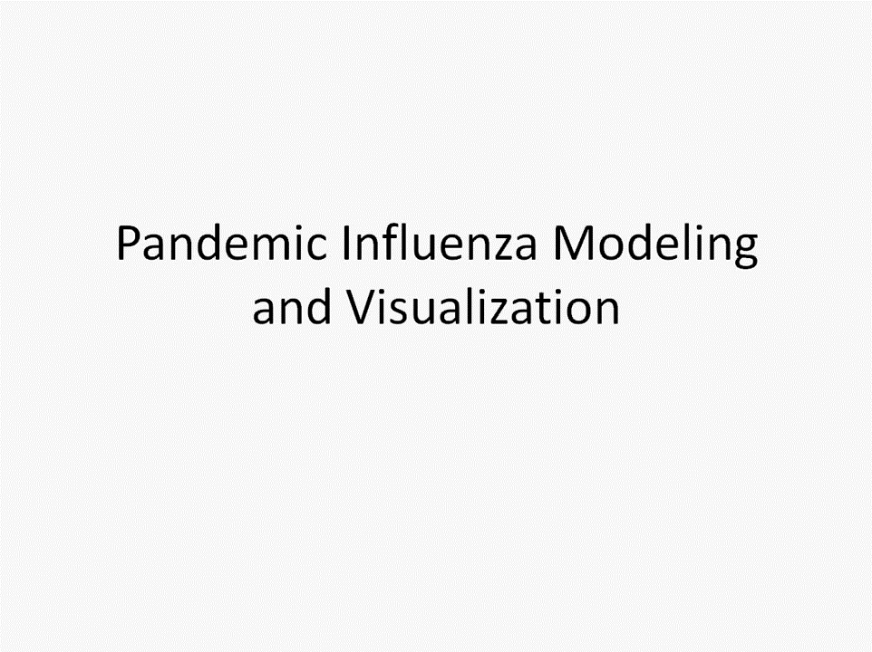

Slide 44
Take Aways
Technology and social systems are interdependent
Ignoring social system, more likely to adversely affect it
Consider peoples interactions and choose appropriate social distance
Create local regions to facilitate interaction
People driven by goals, cost, and payoffs
How will people share information
What impact does and authority figure have?
The makeup of teams is likely to change
Consider what is motivating people
Be aware of issues such as diffusion of responsibility
Social Factors are Complex

