Slide 1
Human Factors Engineering
BME 6086 / BME 4985
Jeffrey Bolkhovsky, Naval Submarine Medical Research Laboratory, University of Connecticut
Jeffrey.Bolkhovsky@uconn.edu
Spring 2019

Slide 2
The ABCs of Users
Anthropomorphic
Behavior
Cognition
Social
Notes:
Anthropometrics: the shape of the body and how it influences what is
designed; consideration of the physical characteristics of intended users such
as what size they are, what muscle strength they have, and so on
Behavior: perceptual and motivational characteristics, looking at what people
can perceive and why they do what they do
Cognition: learning, attention, and other aspects of cognition and how these
processes influence design; users defined by how they think and what they
know and what knowledge they can acquire
Social factors: how groups of users behave, and how to support them through
design; users defined by where they are—their context broadly defined
including their relationships to other people.

Slide 3
Cognition
Mental Representations
Problem Solving
Decision Making
Communication
Notes:
Memory representations are used to understand systems and interact with them
Problem solving is used when its not clear what to do next
Decision making is a more punctuated form of problem solving

Slide 4
Mental Representations
Governs the way people interact with artifacts
Develop over time with use
Refine with use
Can be:
  Structural
  Functional
As complexity increases harder to develop a full model
Partial Models are used
Users behave unusually in novel situations, due to lack of mental model
Notes:
Partial Model:
If you are someone who
drives a car but takes it to someone else for maintenance, for example, the chances
are that you have a relatively simple functional mental model of how the car operates

Slide 5
Mental Representations
Different structures, Example: Electric Circuit
  Series of proposition
  Diagram
  Series of steps (“First flip switch 1, if that does not work…” (Bibby 1996)
Different types:
  Semantic/Propositional
  Visual Spatial

Slide 6
Mental Representations: Types

Slide 7
Mental Representations: Types
Notes:
For this case visual/spatial is better than semantic for building a better model, BUT:
For most tasks users will be better off with the actual numbers
Relative values can be quickly judged but absolute numbers are difficult to measures, a table would probably be best

Slide 8
Mental Models of Users
Usually represent parts of the world and include:
  Structures
  How they interact
  How the user can interact
Example: How many windows are present where you live.
Example 2: Mental model of a Printer
Notes:
For the example: People usually start with a mental model of their home, and frequently walk around in it.
Example 2: So it would include the notion that you feed paper into it,
that the paper gets images and text written onto it, and that the paper comes out of
the printer into some sort of hopper. The mental model might not specify what the
something is that produces the images and text, but could include further
knowledge about the paper path.

Slide 9
Mental Models of Users
Isometric model is a model in which every feature of artifact is represented
People manage complexity by grouping related features together – homomorphic model.
Overly complex models (e.g., internet, space shuttle) tend to be functional
Models will influence:
  How people use a system
  What strategies they tend to employ
  Errors they are likely to make

Slide 10
Mental Models
Notes:
the design of Philadelphia airport‘s
Concourse A violates most people’s mental model and illustrates the role of
mental models in using a system. Users
coming in on the left expect to see Gate A2 between A1 and A3. They might know
that gates are sometimes numbered odd/even by side of concourse, but, in this
case, the nearest gate on the other side is not even visible from most areas around
A1. There are numerous informal signs taped up at A1 noting where A2 is that
have been created by the airline ground staff, who clearly get asked where A2 is
quite often. There are several ways to fix this. The numbers could run A1, A2 and
wrap from A6 on the top to A7 and A8, or A2 and A4 could be A12 and A14.

Slide 11
Mental Models
Notes:
Setting the speed for writing a CD. Which is best? Slow and careful, or faster but
slightly more likely to throw an error? Taken from Toast 10 Titanium

Slide 12
Confidence in Judgement
Judgement in interfaces:
  Is this region clickable?
  Is this the right way to do this?
  Is this the right answer?
Analyzed across various context
Judgement comes from:
  Feeling of knowing
  Word Retrieval
  Strategy selection
  Distance from goal
Notes:
“Just Knowing” - https://www.youtube.com/watch?v=dU7Mhne4CzU

Slide 13
Information that leads to Choice
What leads to that “feeling of knowing”
  Successful use of answer prior
  Being familiar with the domain
  Social expectations
  Social comparisons (others should know, so should I)

Slide 14
Notes:
Cognitive Biases:
ACTIVITY, Choose 1-3 Biases and Answer:
Example of cognitive Bias?
How do you recognize it?
How do you avoid it?
How can you use it to your advantage.

Slide 15
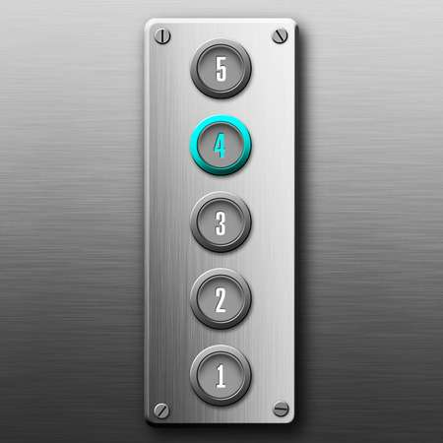
Stimulus Response Compatibility
Stimulus and response should be compatible
Example: Button on an elevator
Task at hand should be mapped to a actions
Notes:
To assist in decision making

Slide 16
Mental Models and Designs
Mental models provide guidance on how to improve the system
Knowing user mental models helps identify areas needing support
Designers usually have a “complete” mental model that frequently differ from those as users.
Users likely to have many different mental models

Slide 17
Problem Solving
Working out how to get from current state to the goal
Studied by watching people solve problems
Watch how people can get from one state to the next
Notes:
The Tower of Hanoi has been used for a long time as a useful illustration of
problem solving. Because it is a relatively simple, clear, but non-trivial problem, it
has been used to study problem solving. There is a clear starting state and a clear
goal state; the operations (operators) that can be applied are fairly evident and easy
to perform, and the constraints are relatively clear. It is easy to see the state of the
disks, and it is basically easy to judge how close you are to the goal state.

Slide 18
Problem Solving
Occurs when users don’t know what to do next
Happens when users are learning
Initial behavior slow and effortful, faster over time
Can be minimized by providing extra info such as handbooks
Notes:
In aviation there is a quick reference handbook.

Slide 19
Problem Solving with Mental Models
Mental models allow people to “operate” without having to recall what to do from memory
Means-Ends Analysis (MEA): notice differences between current state and goal state
Fails when mental model is wrong
Example: Novice writers will notice something is not long enough and simple attempt to write more.

Slide 20
Backtracking
People do not like to move away from their goal.
Difficulty finding solutions that include backtracking.

Slide 21
Backtracking

Slide 22
Biases
Objects and problems are biased by previous experience
Causes problems to be viewed incorrectly.

Slide 23
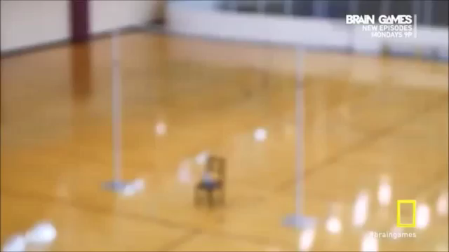
Notes:
Function Fixedness: person fixated on a particular use of an object

Slide 24
Biases
Functional Fixedness: fixated on certain uses of objects
Einstellung: Fixated by certain strategies
  Example: How do you get 3 gallons of water with 1,4, and 5, gallon buckets.
Occur when influence by previous successes.
Notes:
Example 1: Fill 4 gallons, pour into bucket 1.

Slide 25
Einstellung
Notes:
Connect all the dots
with four line segments
without picking up your
pencil

Slide 26
Insight Problems
Novel experience of behavior required
Notes:
Unless you are providing puzzles as part of a game, generally avoid insight problems
Long solutions time per number of steps

Slide 27
Post Completion Errors
When the goal is completed while the subtasks have not
Caused by illustrated problems.
Examples:
  ATM
  Write and don’t send an email
  Send email with no attachment
Notes:
An ATM machine that helps avoid the post-completion error because it does not retain
the card. Another way is to return the card before giving money

Slide 28
Ill Structured Problems
Notes:
Problems are harder when ill structured, avoid these.

Slide 29
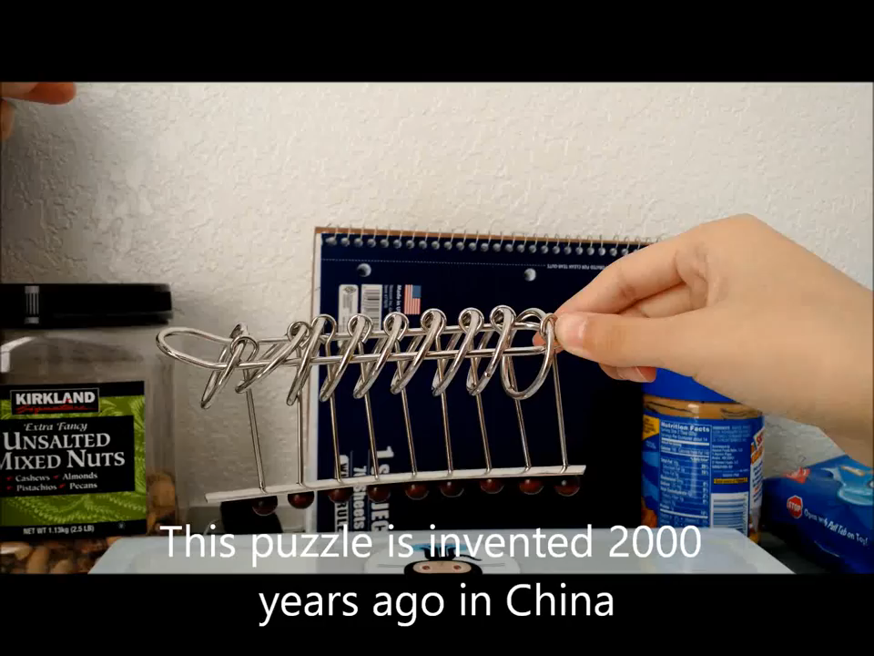
Notes:
Chinese Ring Puzzle: Try to get all the rings off, don’t know how close you are to goal.

Slide 30
Problem Solving and Design
Users will be problem solving, unless they are experts
Avoid insight problems (unless you are building games)
Make operations obvious
  Buttons bigger
  Interactable areas different colors.

Slide 31
Decision Making
Often the mot rational choices are not chosen
Users take into account “potentially” relevant information
Decision making has general, knowable biases
Systematic ways decisions are badly made
Ex: Rather than an optional answer users will typically satisfice
  When looking for cheapest price, will settle for good enough if it means search 10 sites instead of 500

Slide 32
Speed Accuracy Trade Off
Hicks law: Time = b* log₂(number of choices + 1)
Notes:
errors and time can be traded off against each other: the so-called speed–accuracy
trade-off. For any given task, the user’s performance will often range between
very careful and slow, to very fast but less accurate.

Slide 33
Stimuli Response Compatibility For Decisions
Notes:
A bad example of task-action mapping. Which button should you press to cancel the
email, and which button to cancel the canceling of the email, or to OK the sending of the email?

Slide 34
Biases
Confirmation Bias
  Users tend to look at information that confirms their understanding/decision
Regression to the Mean
  Given single instances users generalize
Availability Bias
  Easier time remembering first few/last few items. Primacy/Recency
  Make decision based on memories easier to retrieve.
Framing Effect
  Losing is seen as more costly than gaining
Notes:
Regression: Judging a restaurant by a single meal, could have been a good day or bad day
Framing: Kahneman gave students mugs in class. When
they were asked to sell them back, they wanted $7.12 for them. When they just got
to look at the mugs, and could either collect a mug or get paid, they valued the
mug at $3.50.

Slide 35
Feedback
Decision Making Cannot Improve without feedback
People feel more confident with more decision making despite feedback.

Slide 36
Expertise
Leads to faster, but usually the same decisions
Leads to better recognition over problem solvings
Notes:
Better recognition: They also studied how people played chess as an analogue for other decision
making tasks (Chase and Simon 1973; Gobet and Simon 1996b; Simon and Chase
1973). They found good chess players would consider more reorganization of the
positions and better possible moves than would novices, who would have to do
more problem solving. This expertise would also allow good players to remember
positions more readily because they were not remembering all the pieces individually,
but recognizing groups of pieces as patterns in a way similar to how
ABC, 747, and HFE (and others noted in Table 5.1) might be considered as single
objects instead of three separate characters (Gobet and Simon 1996a).

Slide 37
In Design
Problem solving not always based on logic and rationality.
More time given more choices
Provide more consistent choices to allow for
  Confirming their previous choices
  Providing learning and information to guide future decisions
Give feedback
Minimize biases that hurt, maximize biases that help.

Slide 38
Why don’t user do what they should?
Five Factors that lead to “foolishness”
Unrealistic optimism, assuming things will work out or strategies will work.
Egocentrism, focusing on your own goals rather than a broader set of goals. Sternberg notes cases where focusing on short-term goals hurts long-term goals, and where not looking after others leads to significant problems arising for the leader.
A sense of omniscience, assuming you know all you need to know to make the decision.
A sense of omnipotence, assuming that you are competent in one domain and thus in all, and that the plans you put into action will work.
A sense of invulnerability, that plans cannot go badly wrong given the support you have.
Notes:
One set by Sternberg 2004
These biases in reasoning, however, are well known and occur in nearly everyone.
They offer one set of reasons to explain why people are foolish at times.

Slide 39
Perceived Expertise
Notes:
Perceived
percentile rankings for
mastery of course material
and test performance as a
function of actual
performance rank. Copied
from Dunning et al. (2003)
with permission

Slide 40
Perceived expertise
Notes:
Quote from Dunning et al. 2003
For example, the knowledge to judge whether a sentence is grammatical,
a word is correctly spelled, a diagram is well drawn, or program well
written will be highly correlated with the ability to generate the correct behavior.
So people who generate ungrammatical sentences or perform poorly on these other
tasks are likely to be unable to know that they are ungrammatical.
It means, on average,
users will think that they know more than they do. They will be overconfident
when performing tasks, and they will not always use the right cues to judge their
knowledge.

Slide 41
Communication
Communication with technology relies on a “Common Ground”
Includes:
  Symbols: Object that represents other objects
  Syntax: Organizations of Words
  Semantics: Meanings of Words and Symbols.
Notes:
A diagram of a Theremin. Users play it by moving one hand closer to or farther away
from the volume control and the other hand closer to or farther away from the pitch control. The
distance is measured through capacitance. There are no fixed volumes or pitches, unlike most
other instruments. It is sometimes used to make eerie sounds in science fiction movies
Furnas et al. (1987), for
example, found that there was a wide variability in the words users choose when
asked to name actions: the users agreed on the same term for an action less than 20%
of the time. The results suggest that designers should not just use the first word they
think of, and that they should also support the use of aliases to help match the user’s
terms.

Slide 42
Grices Maxims of Converation (1978)
Notes:
Four Maxims underlying the cooperative principle: You should say things that are the kind of things for the right conversation at the right time.
When these maxims are not followed, you can often
note humor, irony, mistakes, rudeness, and ill-feelings.
Example: Do not report errors when errors don’t exist
13 Minute Lecture: https://www.youtube.com/watch?v=we6uSVf4qss (Probably don’t need to watch in class)

Slide 43
Reading
How much has gone into considerations for reading?
Avg person reads 150-230 words per minute (during comprehension)
2-3 minutes to read a 8.5”x11” page of text
Phenomena:
  Length effect: Longer words take longer to read
    Keyboard vs Autocrat vs Polo
  Word Frequency: Commonly used words take less time to read
    Polo is short but not commonly used
  Reading is faster than picture naming (but once learned icons are faster)
Notes:
“

Slide 44
Things that affect Reading
Font
Line spacing
Size
Bad spleling
Fully Justified Text
ALL CAPS
Abstract pronouns, as they can be difficulty to link to themselves.
Particularly onerous, abstract, and unoften used words.
Grammer that which is not correctly used.
When you don’t not use a double negative.

Slide 45
Notes:
Badly shown information

Slide 46
Notes:
Better shown information.

Slide 47
Font
Font can be used to communicate information better (or worse)
Notes:
(On the left are examples of bad font)
On the right:
Research at Penn State has shown that the
improved font is 20% easier to read, which means that drivers at 60 mph (miles per
hour) can read the road signs 1–2 s earlier, which gives them more time to make
decisions or to read more of the sign.
The previous standard font, Highway Gothic (left) and in the ClearviewHwy font
(right). These signs are on I-78, near Allentown, PA. The Clearview has larger holes in letters like
e and o, and slightly more readable serifs on letters like l and t. The text is particularly more
readable at night when illuminated by headlights.

Slide 48
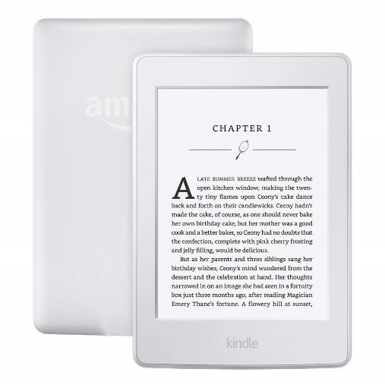
Electronic vs Paper
Reading difference comes from quality:
Paper: 1000 (dpi, dots per inch)
Screen: 250 dpi and high contrast
Paper is usually faster and less fatiguing
Screen is more slow and more error prone (10%-30% on all measures)
Examples to correct:
Notes:
Bigger words prevent issues due to low DPI and screen has less contrast

Slide 49
Scanning/List Behavior
Longer menus take 120ms/item to use (Kieras 1997)
Submenus should be structured around user mental models
Notes:
The original menu for selecting a VPN client at Penn State, and a revised version
created by Ritter for his own use. The version on the left encourages scanning; the version on the
right is more easily read. Simon Robbie notes (personal communication) that hierarchical menus
could be particularly useful here. (Screenshot taken June 2009)

Slide 50
Information
Information can be thought of as organized data
Suffers from “I know it when I see it”
Human Information Behavior Includes how users:
  Process
  Use
  Produce
  Get
  Handle (tactics and strategies)
Influenced by:
  Cognitive
  Perceptual
  Motor
  Tools to access

Slide 51
Consideration for Information Seeking
Humans seek information from:
Multiple or One source
Different ways and Search tools (Google vs Books)
Different Source (and how much they trust sources)
Breath vs Depth and Everything In Between.
Context Dependent but be aware of what users need.

Slide 52
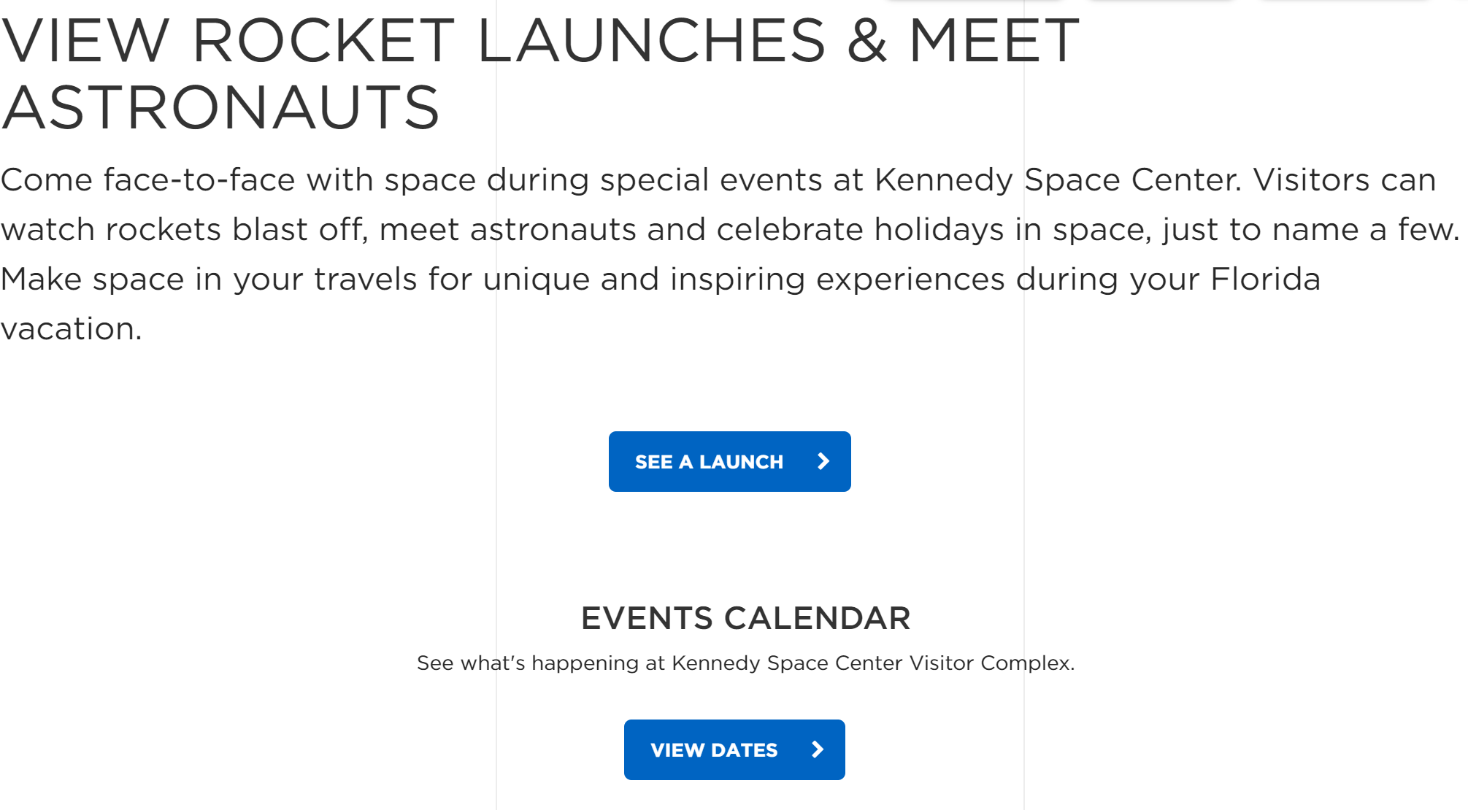
Information Scent
Can guide users to information
Interface metaphorically smells
obtuse or general descriptions remove scent
Notes:
If someone is looking for rockets or launch times

Slide 53
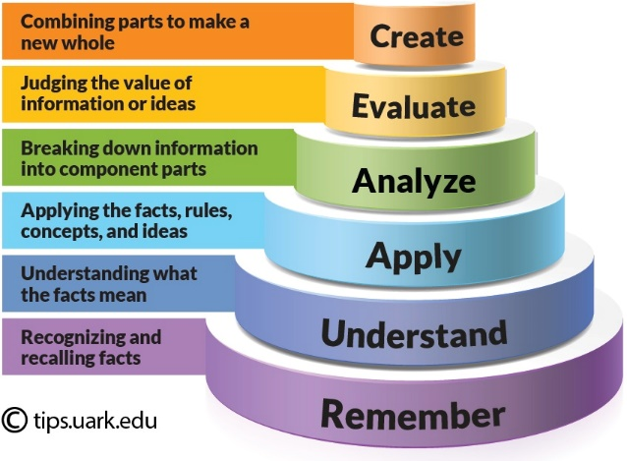
Creating Information Content
When developing strategies for proving information:
  Less is more, users probably want to get key objectives
  Understand existing concept
  Good Listener (change content based on user needs)
  Someone needs to be responsible.
  Ask questions (justify why you are providing)
Remember to
  Audit
  Analyze
  Create

Slide 54
Creating Content
What type of writing captures users?
General rule of thumb aim for: 12 Years old
Flesch Reading Ease Score
Flesch-Kincaid Grade Level Score

Slide 55
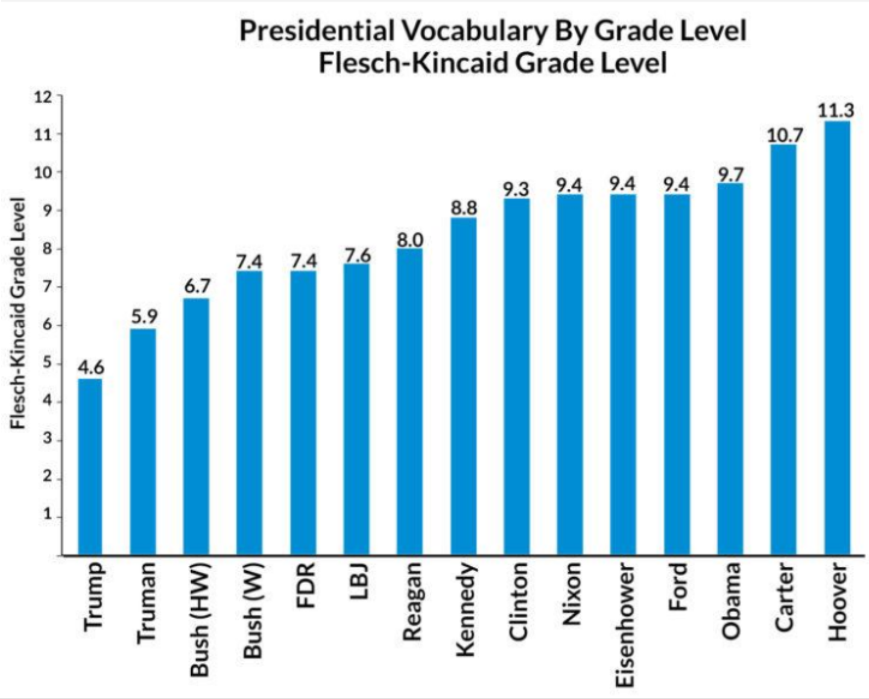

Slide 56
Information Organization
Users organize in a structure
Does not mean you should put in a graph structure
Need to fit to a potential mental representation
Accommodate user capabilities and previous knowledge where you can.

