Slide 1
Human Factors Engineering
BME 6086 / BME 4985
Jeffrey Bolkhovsky, Naval Submarine Medical Research Laboratory, University of Connecticut
Jeffrey.Bolkhovsky@uconn.edu
Spring 2019

Slide 2
The ABCs of Users
Anthropomorphic
Behavior
Cognition
Social
Notes:
Anthropometrics: the shape of the body and how it influences what is
designed; consideration of the physical characteristics of intended users such
as what size they are, what muscle strength they have, and so on
Behavior: perceptual and motivational characteristics, looking at what people
can perceive and why they do what they do
Cognition: learning, attention, and other aspects of cognition and how these
processes influence design; users defined by how they think and what they
know and what knowledge they can acquire
Social factors: how groups of users behave, and how to support them through
design; users defined by where they are—their context broadly defined
including their relationships to other people.

Slide 3
Cognition
Memory
Attention
Learning
Notes:
Memory attention and learning are intertwined into user’s cognitive processing.
Building blocks of information processing, and how we use information.
Each of these factors move into how well people perform or use the objects and processing you give them.

Slide 4
Memory
Three Types:
  Mental function of retaining information (storage and retrieval of memory)
  Hypothesized storage system in the brain (memory)
  Information itself that is stored (items in memory)
Relevance of Memory; Interfaces influenced by:
  Processing of short term memory
  Long-term memory
  By how well users retrieve commands and objects from memory.

Slide 5
Type of Memory
Episodic Memory (particular time and place)
Semantic Memory (object types)
Declarative Memory (facts)
Procedural Memory (how to do a task or acts)
Notes:
Procedural Memory is generally more robust to decay

Slide 6
Iconic Memory
What you remember after you close your eyes
Visual Iconic memory usually holds 2-3 items (under debate)
Decay fairly fast
Remain for 500ms if not processed
Items that appear for a short time need to be processed to be remember.
Notes:
Iconic memory is memory that is not “processed”

Slide 7
Short-Term Memory (Psychology)
Information that decays with time
“Forgetting a phone number by the time you get to the phone”
Users remember 7 meaningful objects (+/- 2) (Miller 1956)
Some found information can start to disappear in about 5 seconds if not rehearsed.

Slide 8
Short Term Memory – Better Recall
Primacy
Distinctive Items are easier to remember.
Items in a list that make more sense:
  ABC, NBC, CBS
  SCE, ORD, PIA
Recency
Notes:
Primacy: Remember better because it comes first.
Distinctive Items only work if they are distict (you cant just turn everything red/orange)
Recency: Remember better because it came last.

Slide 9
Working Memory (Psychology)
  Dynamic
  Small capacity
  Temporary Memory Storm
    Rapid access (~ 70ms) & decay (~200 ms)
    Holds about 2 sec
  More about context and actual processing of information.
  Information frequently goes to long term memory afterwards.

Slide 10

Notes:
Change Blindness

Slide 11
Long Term Memory (Psychology)
  “Permanently” encoded information
  Requires enough processing
  Huge (if not “unlimited”)
  Slower access time (~100 ms) w/ little decay
  Meaningful encoding makes memory last longer and can assist in remembering more.
  Easier to remember things if components are already known.
  Declarative knowledge requires attention to go to LTM.
  Procedural can sometimes go to LTM with less attention.
Notes:
How much time it takes to make an item go from short-term to long term memory is argued
Easier to remember a hotkey (ctr-c) if you know what a computer is and a keyboard is
There is a debate about how long term memories are stored and that whether they decay and are no longer there or can no longer be distinguished because they are no longer unique (like you can recognize landmarks when driving somewhere but cannot recall them beforehand)

Slide 12
Implicit vs Explicit Memory
Explicit memories are reportable
  Frequently leads to more robust performance
  Can inform others
Implicit memories are not
  Procedural are implicit: precise details not reportable
  Recognizing objects without knowing how

Slide 13
Explicit vs Implicit
Notes:
Two types of interfaces for the 8 puzzle that lead to different types of learning.
a Interface leading to more explicit representation. b Interface leading to more implicit
Representation
Subjects who used the second interface were less able to describe how they solved it but solved it faster.

Slide 14
Prospective Memory
Memory involved with doing things at the appropriate time.
Storage of information for future activities is prone to failure.
Major Human Factors Area
  Schedulers
  Calendars
  Lists
  Alarms

Slide 15
Mnemonics and Aids to Memory
Use of tools to increase amount, quality, or speed of recall of information.
Many Methods such as Loci
Recognition more robust than simple recall
  Recognizing objects in a menu
  Slower for experts (e.g, recalling a single keystroke)
Anomalous things are easier to remember (e.g., bell being played with a word)
Practice and repetition, seeing again.
Notes:
Loci: In this
mnemonic, a speaker (typically) would store in memory something familiar to
them, like a set of locations in their house. They would then associate the items
that they later wanted to with these locations. Retrieving a set of items in this way
is much more robust than trying to recall each item individually without any
associated, structured context.
It is easier to recognize something you have previously seen than it is to recall what is was you saw.

Slide 16
PQ4R
Preview
Question
Read
Reflect
Recite
Review
What is it? Who is it by? What does it say? What does it imply? Do we believe it?
So, begin with the end in mind, Section 14…
Notes:
How to apply what we know to learning something.
Reflect frequently means to write

Slide 17
Biases in Memory
Interference:
  The retrieval of items from memory can be helped or hurt by other items in memory.
  Two items can be a confused for one another.
  If you learn someone’s name wrong its hard to fix it.
Retrieval Bias
  Items retried to support reasoning will be biased towards primacy/recency.
  Information that is stored in a context will be easier to retrieve.
Notes:
Loci: In this
mnemonic, a speaker (typically) would store in memory something familiar to
them, like a set of locations in their house. They would then associate the items
that they later wanted to with these locations. Retrieving a set of items in this way
is much more robust than trying to recall each item individually without any
associated, structured context.
It is easier to recognize something you have previously seen than it is to recall what is was you saw.

Slide 18
Biases in Memory
Encoding Effects:
  Content of an item stored in memory
  Location, sight , smell sound
  Associate memory with the properties
Priming
  Presenting objects before use facilitates their use
Lotus Effect
  Taking on knowledge from questions
Notes:
Priming:
‘‘bed rest awake tired dream wake snooze blanket doze slumber snore nap peace yawn drowsy,’’ many
subjects will report that ‘‘sleep’’ was included as well. This effect can be explained
by noting that many, if not all, of these words prime the word ‘‘sleep.’’
Lotus: What color hat was the suspect wearing later prompts people to thing the suspect was wearing a hat
Did you ever meet bugs bunny in Disney world as a child? Bugs Bunny is warner brothers

Slide 19
Implications
Recognition over Recall
Recall
  Info reproduced from memory
Recognition
  Presentation of info provides knowledge that info has been seen before
We want to design UIs that rely on:
  Recognition for novices and once-only tasks
Implications of Memory for Interface Design
  Trying harder does not help
  Ordering the presentation of objects to memory helps
Notes:
Implications

Slide 20
Attention

Slide 21


Slide 22
Attention
Attention is a limited resource
Covers selective aspects of perception
Can be seen as a set of buffers that hold information
If the system is doing one thing, it can’t be doing another. If it’s buffers are full of TV, it can’t process readings

Slide 23
Beyond Conscious Attention
Some information can be processed without consciously attending
Cocktail Party Effect
  Hearing your name in a different conversation
Limited to surface features, syntactic properties, shadow features
Difference between hearing and understanding
Frequently comes with extensive practice

Slide 24
Attentional Resources
Notes:
These define resources for processing and holding information,
with some tasks using more of one type of resource than another.
Most of the evidence to support Wickens’ model of attentional resources comes
from studies of dual task performance.
Evidence for two different types of
resources, for example, can be found by varying the difficulty of responding to one
task and looking at performance on a concurrent (more) perceptual task. The
performance on the perceptual task is (more or less) constant, even though more
resources are needed for the responding task.

Slide 25
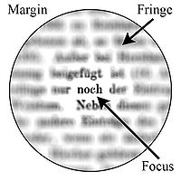
Models of Attention
Spotlight
Zoom
Divided Attention
  Perform better with larger blocks of time

Slide 26
Actions and Interruptions
Slips of Actions – Performing the Wrong action
  Open Loop Control
  Closed Loop Control
Interruptions
  Can be seen as a secondary task that takes attention
  Usually cause issues with performance
  Sometimes benefit (Incubation effect)
Automation
  ‘‘Do you ever wake up and find out you are driving and wonder where you are going and where the other cars are?’’
  Give status updates when human may have to take over for automated systems.
Notes:
1. Using open loop control: behavior is based on anticipation and feedforward
rather than feedback, so there is little or no need for them to monitor the result of
their actions. Other activities can be performed at the same time—automatized
driving and game play and typing are examples. (Not looking at a cursor when typing)
2. Using closed loop control: performance is mediated using feedback on any
actions carried out, so conscious monitoring of behavior is required. Only one
activity can be carried out at one time. Learning how to drive, deliberate
walking on a rock field, editing a manuscript are examples, or learning how to
play a game by mapping commands to a controller.
Kaplan
(1989) found that at least part of the incubation effect came from cues in the
environment. One problem he gave subjects was ‘‘What goes up a chimney down
but not down a chimney up?’’ Subjects who were called and asked by Kaplan if he
had left an umbrella in their office were much more likely to solve the problem, but
did not attribute the cause to his call.

Slide 27
Implications for Systems
Help do multiple tasks by requiring less attention for each tasks.
Create indicators of new tasks such as a beep or flash.
Have users pay attention to a process before it is necessary to perform it.
Notes:
This system shown
here included an instant
messenger (iChat) text and
video chat, a proprietary
video conferencing tool,
slides of the talk online and
printed, as well as paperbased
reminders and notes. In
this task, however, the
subtasks were integrated: to
watch the man in the suit talk
and ask him questions

Slide 28
Learning
Process of Learning
  Stage 1 (Cognitive): Acquire domain declarative information
  Stage 2 (Associative): Declarative knowledge compiled to procedural information
  Stage 3 (Skills or Tuning): Tunes knowledge that is applied
Tasks become
  Faster
  Less demanding
  Less error prone
  Recalled faster
  Recognized Faster
  Recalled with higher quality

Slide 29
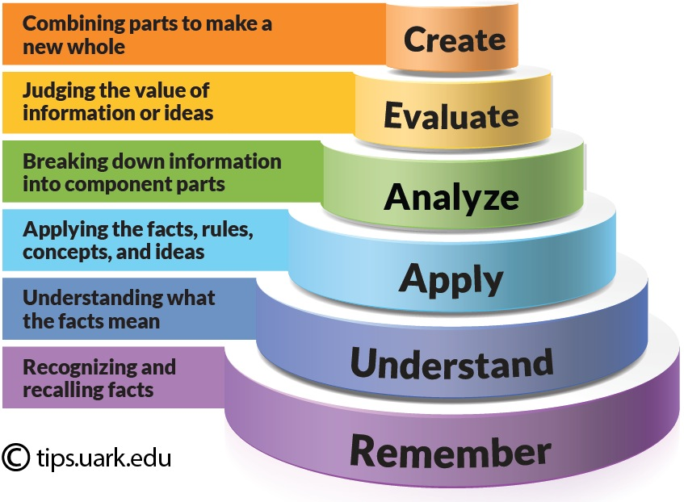
Learning
Notes:
Learning fits blooms taxonomy.

Slide 30
Power Law of Learning (Reminder)

Slide 31
Types of Learning
Declarative – Learning with Facts
  Recognition
  Recall
  Recognition is easier – why multiple choice are easier
Procedural – How to do procedures
  More complex than declarative
  Don’t come until declarative memories are available to create procedures
Learning is more flexible than expected
  Introspection not supported by psychology
Notes:
As an example of this, users think that they cannot learn new key bindings
between keys and commands (e.g.,\Ctrl-s[to search vs.\Ctrl-f[to search). When
key bindings in an editor were changed on users on the second day of a study about
learning to use a text editor, for the first hour or two the users felt much, much slower.
They were slower than they were at the end of the first day, but faster than when they
started. They regained their skill level by the end of the second day (Singley and
Anderson 1989). This study illustrates three important things about users. The first is
that they are always learning. The second is that introspection often leads to incorrect
conclusions. They rather disliked the new interface, but they adapted more quickly
than they thought they did.

Slide 32
Types of Learning
Implicit
  Automatic
  Based on practice
  Not improved by reflection
  Cannot be verbalized
Explicit
  Requires full consciousness in a hypothesis testing way
Massed – All at once
Distributed – occurs with breaks and learning episodes
  Better retention than massed
  Interfaces put up hints to support distributed learning

Slide 33
Massed and Distributed Learning

Slide 34
Expertise
Usually takes 10 years of practice
Deliberate reflection and declarative learning
Simple practice not enough
Expert Users
  Speed
  Greater memory
  Pay more attention
  Better anticipation
  More accurate perception of details

Slide 35
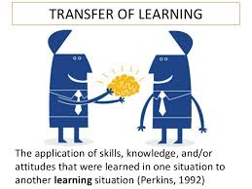
Transfer
Notes:
Perhaps the earliest study on transfer had subjects read a story about how a king
wished to invade a town, but his army was too big to come through a single gate in
the town. So he split his troops up into smaller parties. Subjects then read about the
use of lasers to attack cancer, but the problem was that the light was too intense to
directly fire through the tissue at the cancer. What to do?
A surprising number did not think to use multiple lasers, which is what the
transfer of knowledge would suggest. This lack of obvious (to the experimenter)
transfer effect has been repeated many times. Problem solvers have trouble
transferring knowledge or strategies where there are structural but not surface
similarities. Thus, users do not always transfer useful information.

Slide 36
Implications for Design
Vision
  Work with vision
Memory & Attention
  Assume limited attention
  Help attention
  Help memory
  You can assume failures will occur
Learning
  You can almost count on it
  You can help it
  But you can’t always predict pace, amount, transfer
Have a theory for what will happen
  People learning problems by type learn how to apply algorithm
  People learning how to choose know which algorithm to apply
  Students tested on the other task, which they did not learn, will not perform well
Does not matter much what instructor do, it matters what learner does

Slide 37
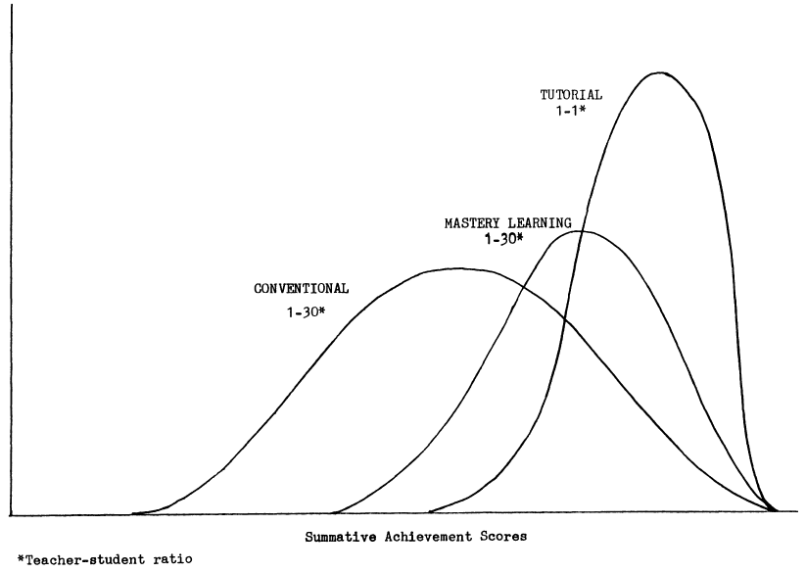
What is Bloom’s 2 Sigma Problem
Bloom found that the average student tutored one-to-one using mastery learning techniques performed two standard deviations better than students who learn via conventional instructional methods.
The average tutored student was above 98% of the students in the conventional instruction class.
~ 90% of the tutored students attained the level of achievement reached by only the highest 20% of the conventional instruction class
Notes:
In 1984, Bloom published "The 2 Sigma Problem: The Search for Methods of Group Instruction as Effective as One-to-One Tutoring"
Bloom found that the average student tutored one-to-one using mastery learning techniques performed two standard deviations better than students who learn via conventional instructional methods that is, "the average tutored student was above 98% of the students in the control class". Additionally, the variation of the students' achievement changed: "about 90% of the tutored students ... attained the level of summative achievement reached by only the highest 20%" of the control class.

Slide 38
Where Bloom Left-off
Bloom concluded that one-to-one tutoring was too costly for most societies, on any sort of a large scale.
Bloom challenged researchers and teachers to find methods to make group instruction as effective as one-to-one tutoring.

Slide 39
Welcome to the 21st Century

Slide 40
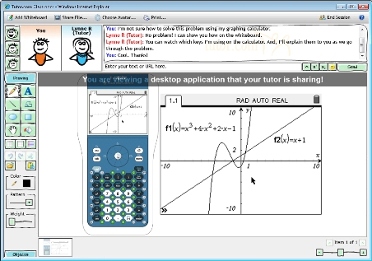
On-line tutoring
24/7 tutoring on-line with a real person

Slide 41
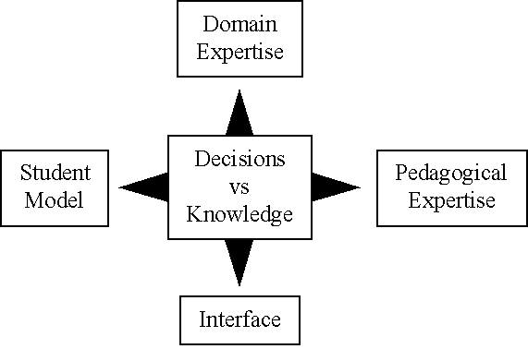
Intelligent Tutoring Systems
Artificial Intelligent system are being developed to augment the class instructions.

Slide 42
Assessment of Tutoring Systems

Slide 43
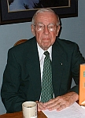
Who is Donald Kirkpatrick
Professor Emeritus of the University of Wisconsin
Past president of the American Society for Training and Development (ASTD)
Best known for creating the four levels of training evaluation, first published in 1959, in a series of articles in the US Training and Development Journal.
Notes:
Professor Emeritus of the University of Wisconsin
Past president of the American Society for Training and Development (ASTD).
He is best known for creating a highly influential model for training program evaluation, consisting of four levels of training evaluation (see also Course evaluation). Kirkpatrick's ideas were first published in 1959, in a series of articles in the US Training and Development Journal but are better known from a book he published in 1975 entitled, "Evaluating Training Programs".

Slide 44
Kirkpatrick’s Four-Level Assessment Model
Reaction - what students thought and felt about the training (satisfaction; “end of term evaluation form")
Learning - the resulting increase in knowledge and/or skills, and change in attitudes (“end of term exam score”)
Behavior - transfer of knowledge, skills, and/or attitudes from classroom to the job (change on-the-job behavior due to training program)
Results - the final results that occurred because of attendance and participation in a training program (can be monetary, performance-based, etc.)
Notes:
Reaction: A measure of how trainees feel about the various aspects of a training program, including the topic, speaker, schedule, and so forth. Reaction is basically a measure of customer satisfaction. It’s important because management often makes decisions about training based on trainees’ comments. Measuring reaction also ensures that trainees are motivated and interested in learning.
Learning: This is a measure of the knowledge acquired, skills improved, or attitudes changed due to training. Some programs aim to improve trainees’ knowledge of concepts, principles, or techniques. Others aim to teach new skills or improve old ones. And some programs, such as those on diversity, try to change attitudes.
Behavior: This is a measure of the extent to which trainees change their on-the-job behavior because of training. It’s commonly referred to as transfer of training.
Results: This is a measure of the final results that occur due to the training, including increased sales, higher productivity, bigger profits, reduced costs, less employee turnover, and improved quality.

Slide 45
Kirkpatrick’s Model
(Critique and Response)
“The Flawed Four-Level Evaluation Model,” written by Elwood F. Holton of Louisiana State University, in Human Resource Development Quarterly, Spring 1996 said that the four level model is too simple. Houlton claims that the model is not a model at all, but a taxonomy or classification.
Kirkpatrick (1996) concedes that Holton may be correct. However, he does not care whether it is a model or taxonomy, as long as training professionals find it useful in evaluating training programs.
“It [the Four-Level Model] is simple and practical. Many trainers aren’t much interested in a scholarly, complex approach. They want something they can understand and use.” (Kirkpatrick, 1996)

Slide 46
Dimensions rather than Levels/Steps
Behavior
(Transfer of Training)
Learning
(Knowledge, skills, attitude)
Reaction
(Trainee’s feelings)
Results: This is a measure of the final results that occur due to the training, including increased sales, higher productivity, bigger profits, reduced costs, less employee turnover, and improved quality. However, the final results are often dominated by factors outside of training.

