Slide 1
Human Factors Engineering
BME 6086 / BME 4985
Jeffrey Bolkhovsky, Naval Submarine Medical Research Laboratory, University of Connecticut
Jeffrey.Bolkhovsky@uconn.edu
Spring 2019

Slide 2
Stakeholders
A stakeholder is either an individual, group or organization who is impacted by the outcome of a project.
They have an interest in the success of the project, and can be within or outside the organization that is sponsoring the project
https://www.projectmanager.com/blog/what-is-a-stakeholder

Slide 3
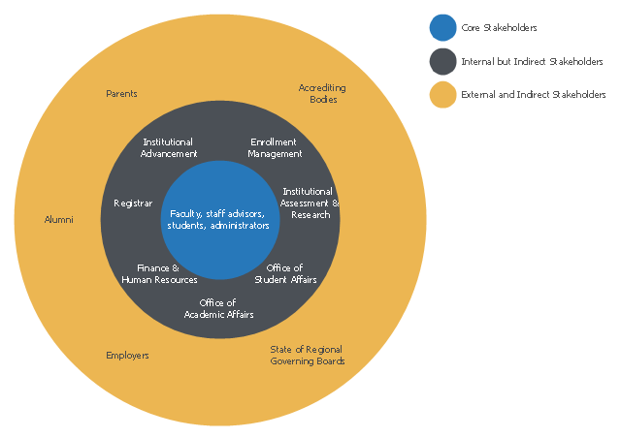
Stakeholders for Academic Advising
Harney (2008)
Notes:
This onion diagram example was designed on the base of figure "Academic advising stakeholder framework" in the article "Defining Advising Stakeholder Groups"

Slide 4
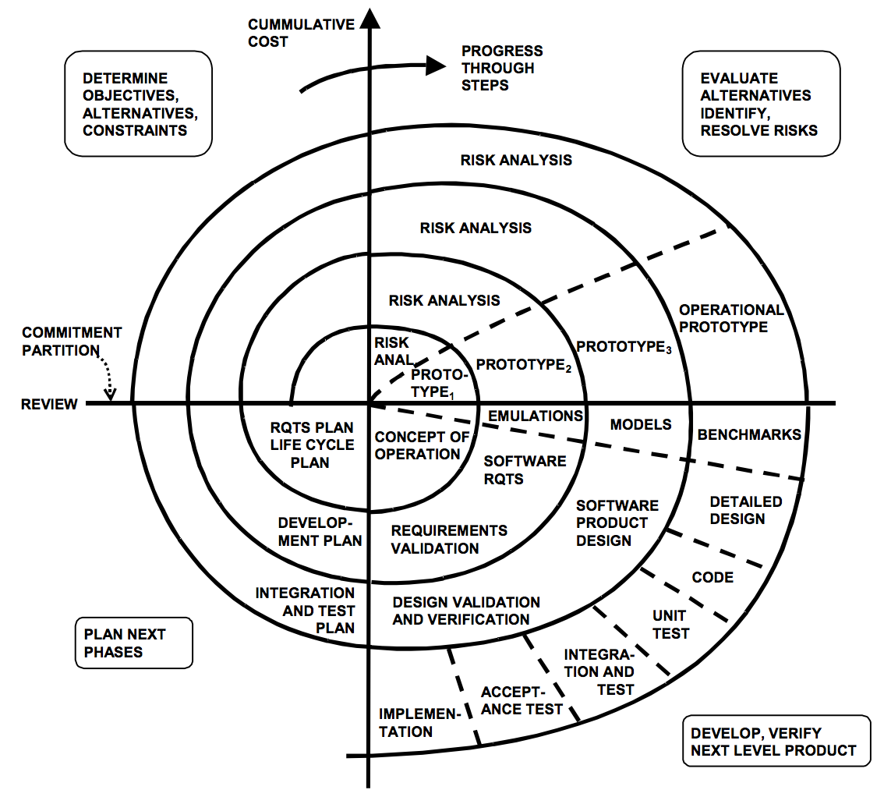
Spiral Model
TALK, CROSS. "The spiral model as a tool for evolutionary acquisition." Start Your Software Odyssey Here 801 (2001): 4.
Notes:
Reading Required: TALK, CROSS. "The spiral model as a tool for evolutionary acquisition." Start Your Software Odyssey Here 801 (2001): 4.

Slide 5
Why Spiral vs One Step?
Cyclic Approach for incremental growth
Decreasing degrees of risk, each step is calculated to reduce the most significant risk.
Anchor point milestones for ensuring stakeholder commitment
Answers Question what should be done next?
Answers Question how long to continue?
Notes:
-Cyclic Approach for incremental growth
-Decreasing degrees of risk, each step is calculated to reduce the most significant risk.
-Anchor point milestones for ensuring stakeholder commitment
-Answers Question what should be done next?
-Answers Question how long to continue?

Slide 6
Requirements for a Spiral Model?
Concurrent Determination of Key Artifacts
Each cycle does objectives, constraints, alternatives, risks, review, and commitment.
Level of effort driven by risk considerations.
Degree of detail driven by risk considerations.
Use anchor point/milestones.
Emphasis on system and lifecycle activities and artifacts.
Notes:
1) You need to know what your system looks like to make a single cycle/assumes on pre-specifiable, slowly changing, known architecture
2) Stakeholder objectives and constraints are necessary to know to continue development/ assumes that stakeholders are involved.
3) There is risk not only through developing too quick but also not quick enough, i.e. competitors/ assumes that you have risk
4) If its risky to specify don’t, if its risky to not specify do/ assumes not everything is pre-specified
5) Avoid analysis paralysis, unrealistic expectations, requirements creep, drift, shortfalls, incompatibilities, unsustainable architectures, useless systems./ assumes an initial architecture is available.
6) Will it satisfy stakeholders? Will it meet cost and performance goals? Will it integrate? Adapt? / assumes system is no abstract

Slide 7
Terms and Areas of Human Factors
User Centered Design (UCD)
Human Centered Design (HCD)
User Experience (UX)
Interaction Design (IxD)
Human-Computer Interaction (HCI)

Slide 8
User Centered Design (UCD)
Human Centered Design (HCD)
Focusing on User Needs
Task or activity analysis
Requirements Analysis
Testing an Evaluation
Iterative Design
Understanding human capabilities and characteristics
How they are affected beyond direct interaction
Humans are seen as central element

Slide 9
User Experience (UX) – Part of HCD
A person’s perception and response from use or anticipated use
Beyond just interface design
Address many external aspects :
  Emotion
  Belief
  Preference
  Perceptions
  Physical Responses
  Psychological Responses
  Behaviors
  Accomplishments

Slide 10
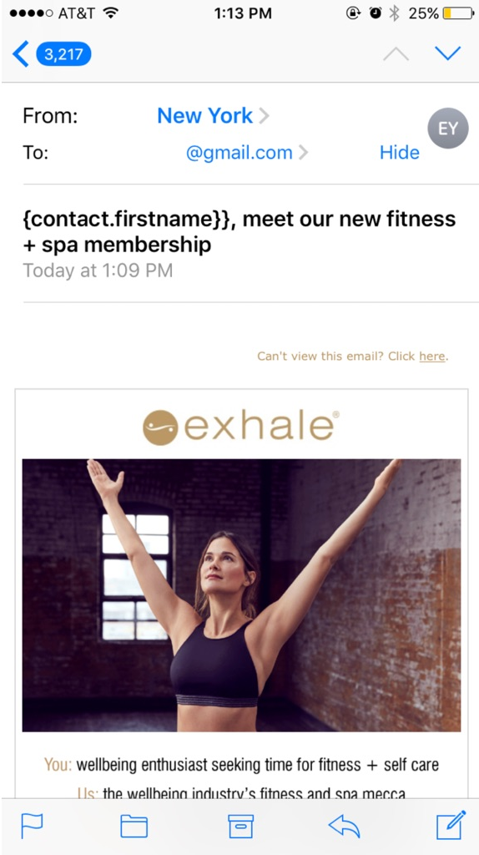
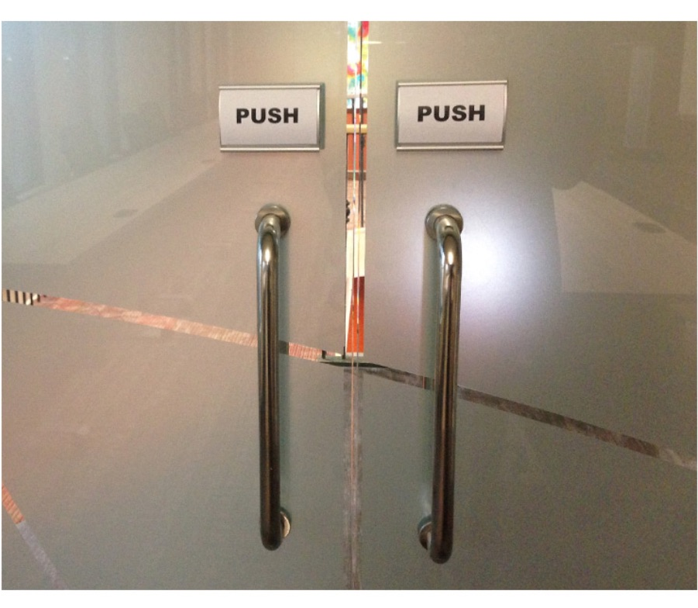
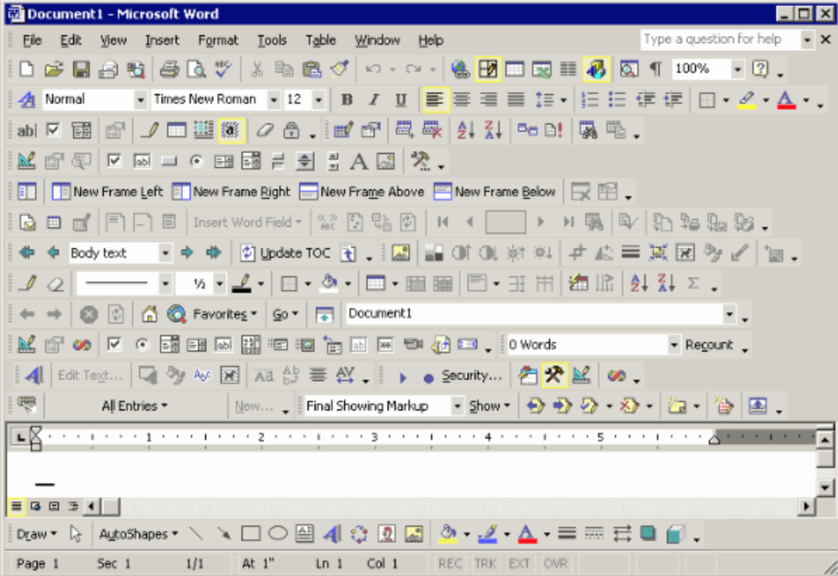
User Experience
https://www.appcues.com/blog/bad-ux-mistakes

Slide 11
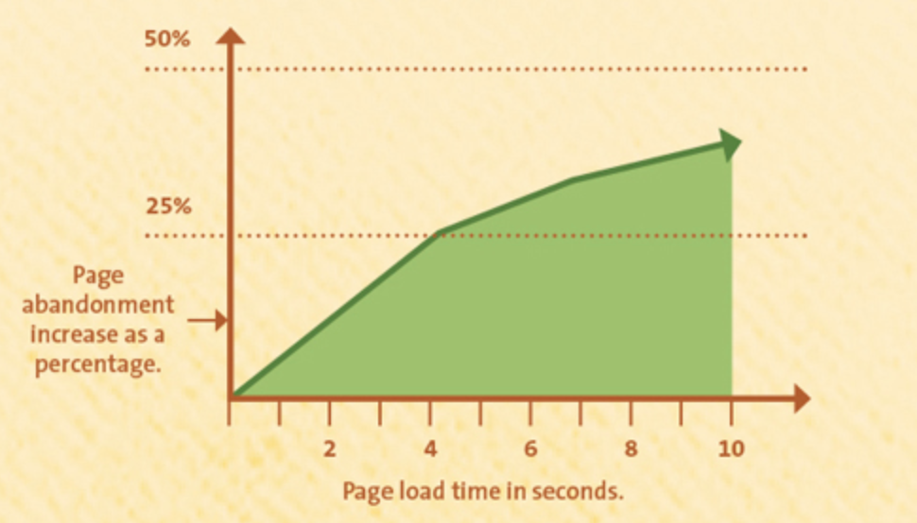
User Experience Example
https://www.appcues.com/blog/bad-ux-mistakes

Slide 12
The Game of “15”
Let’s play a game: the game of “15.” The “pieces” for the game are the nine digits: 1, 2, 3, 4, 5, 6, 7, 8, 9. Each player takes a digit in turn. Once a digit is taken, it cannot be used by the other player. The first player to get three digits that sum to 15 wins.
Example game:
1) Player A takes 8.
2) Player B takes 2.
3) Player A takes 4.
4) Player B takes 3.
5) Player A takes 5.
Play A: 8 4 5
Play B: 2 3 ?

Slide 13
The Game of “15”
(the smarter way)
1 2 3 4 5 6 7 8 9
Play X: 8 4 5
Play O: 2 3 ?
Notes:
Game of 15, try to add 3 numbers together to add up to 15, but once a number is chosen by a player it can not be used again by either player.

Slide 14
The Game of “15”
(the smarter way)
4
3
8
9
5
1
2
7
6

Slide 15
Principles for Designing Systems for Users

Slide 16
Principles and guidelines for Designing a System
  Functionality
  Usability
  Learnability
  Efficiency
  Reliability
  Maintainability
  Utility
Notes:
Functionality: What something does.
Usability: Complex Concept (See next slide)
Learnability: How easy it is to learn.
Efficiency: Choose a resource of a system and using that as a measure (i.e. processing time)
Reliability: Is the system complete, consistent, robust?
Maintainability: How is is the system to maintain, in terms of cost and frequency?
Utility: Is it useful?

Slide 17
Usability
Ravden and Johnson (1989)
  Visual clarity
  Consistency
  Informative feedback
  Explicitness
  Appropriate functionality
  Flexibility and control
  Error prevention and control
  User guidance and support.
Eason (1984) the ‘‘major indicator of usability is whether a system or facility is used.’’
  system function-task match
  Task characteristics
  User characteristics
Shackel (1991)
  Effectivness
  Learnability
  Flexibility
  Attitude

Slide 18
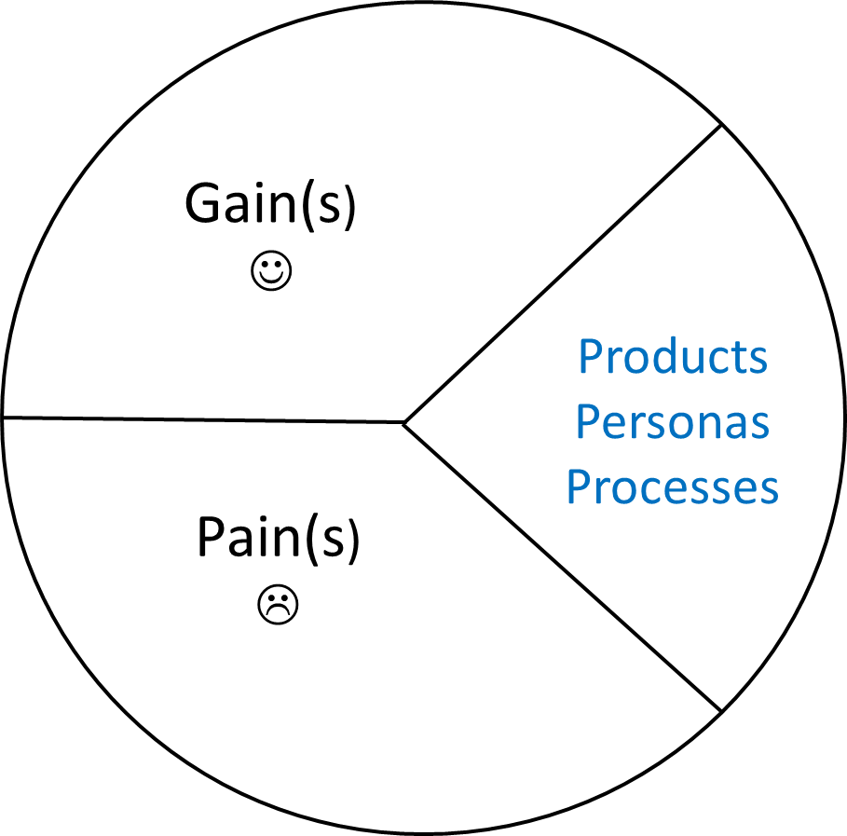
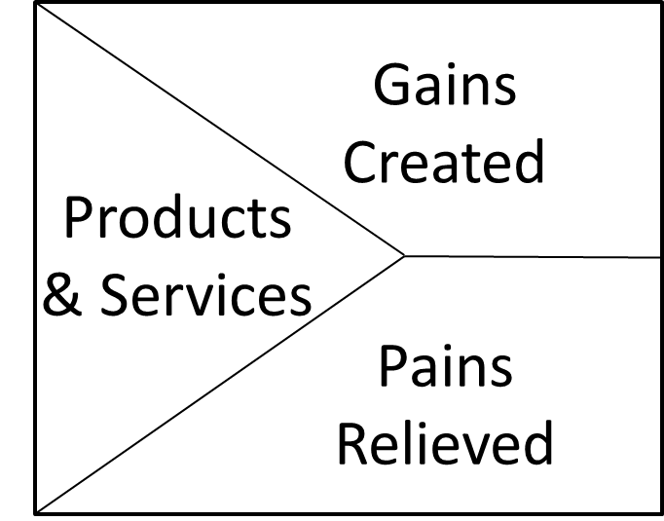
User Centered Design:
Possibility Generation
Possibility

Slide 19
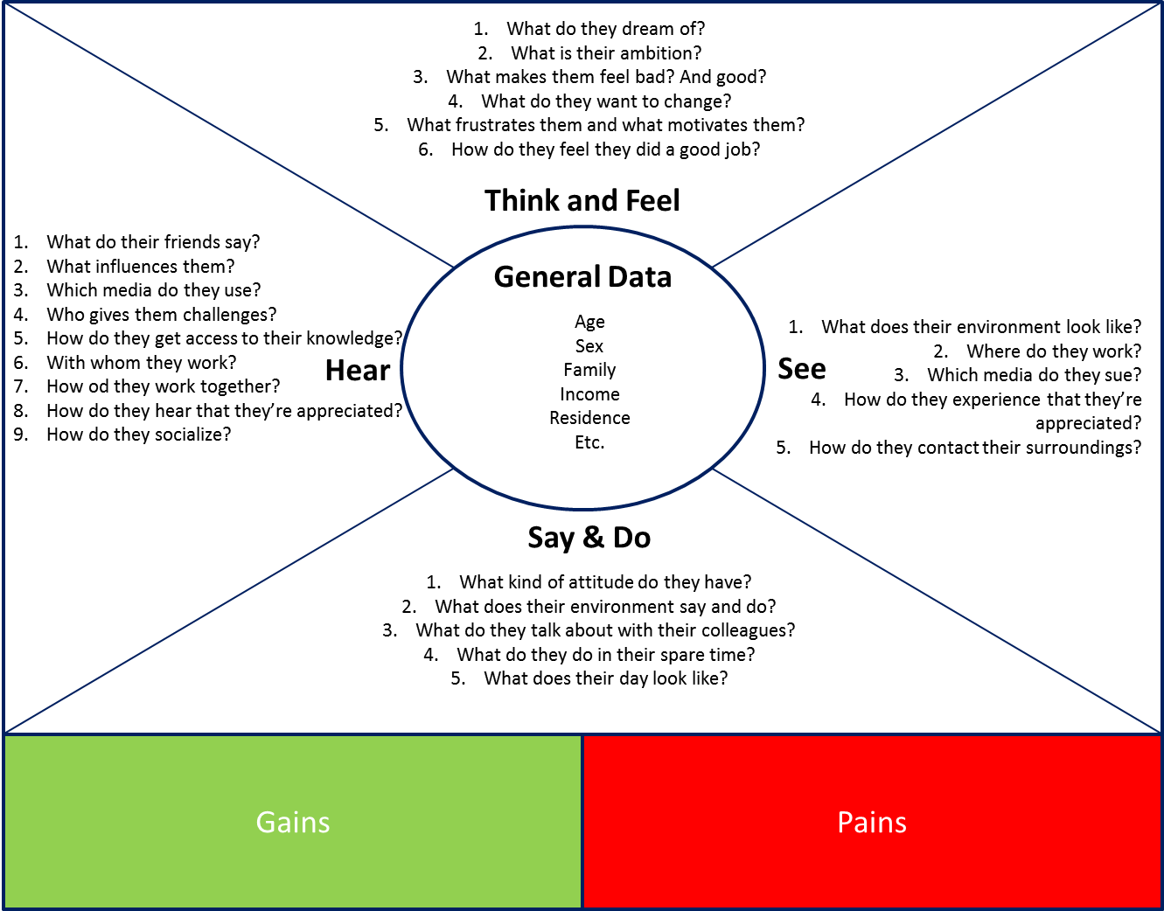
What is a Persona?

Slide 20
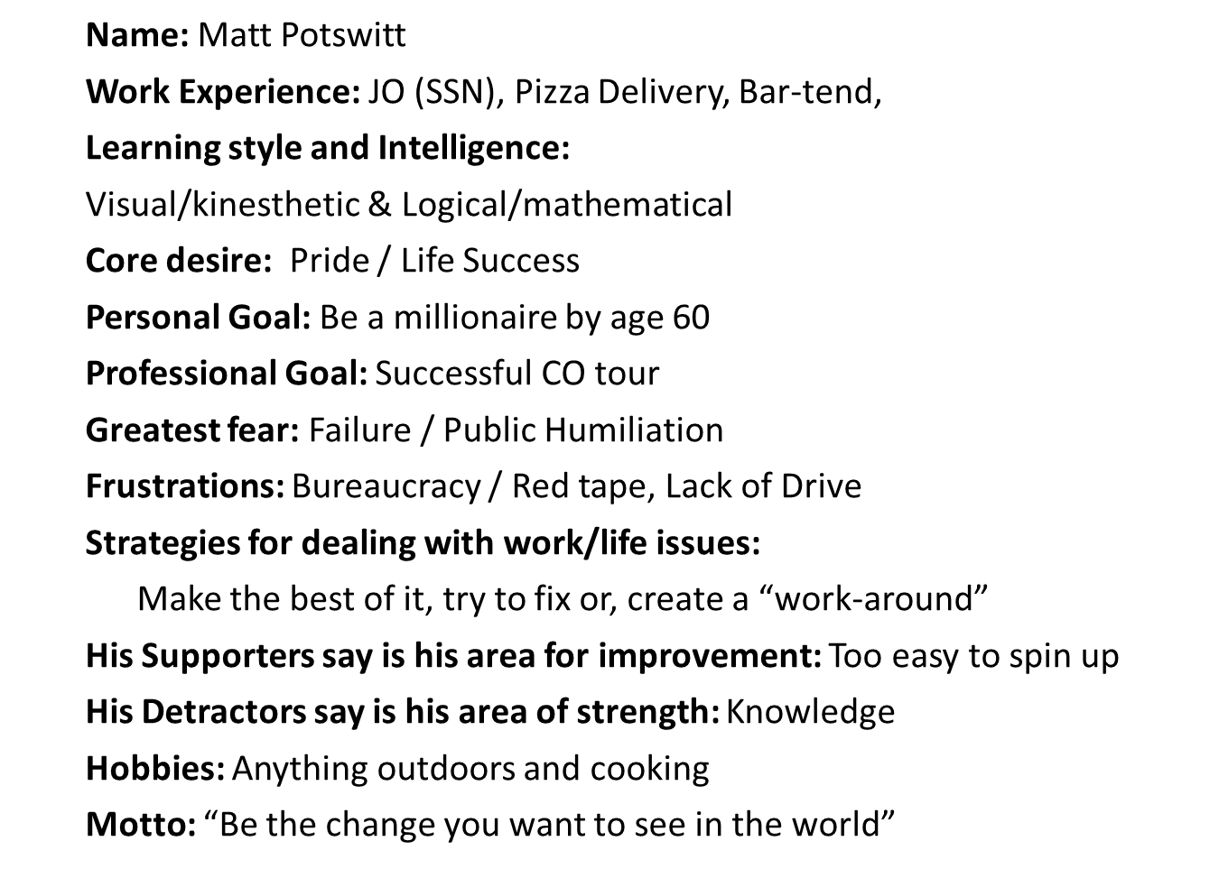
User Centered Design:
Example Persona

Slide 21
Notes:
Exercise: Split into three groups and make 3 personas each and then present them.

Slide 22
The ABCs of Users
Anthropomorphic
Behavior
Cognition
Social
Notes:
Anthropometrics: the shape of the body and how it influences what is
designed; consideration of the physical characteristics of intended users such
as what size they are, what muscle strength they have, and so on
Behavior: perceptual and motivational characteristics, looking at what people
can perceive and why they do what they do
Cognition: learning, attention, and other aspects of cognition and how these
processes influence design; users defined by how they think and what they
know and what knowledge they can acquire
Social factors: how groups of users behave, and how to support them through
design; users defined by where they are—their context broadly defined
including their relationships to other people.

Slide 23
Anthropomorphics
The shape of the body and how it influences what is designed.
Consideration of the physical characteristics: size/strength
Notes:
Will a person be able to physically reach a handle? Are there fingers small enough to manipulate the buttons?
In computer systems these problems include making sure that controls (knobs, dials, buttons, etc) can actually be manipulated by a wide range of users.
Ted Williams, the famous
American baseball player and fighter aircraft pilot, reportedly crash-landed a plane
rather than eject so that he would be able to play baseball again after the Korean
war—the design error was that ejector seats were designed for the average height
of a pilot, which left those in the upper 5–10% of the height range in danger of
damaged or removed kneecaps if they ejected.
http://www.tedwilliams.com/index.php?page=burnjet

Slide 24
Anthropomorphics
How do you want to design and how do you capture that?
  For the individual?
  For the average?
  For the extremes?
Notes:
If you are personalizing what are you looking for?
If you design for the average who are you excluding and what is your target?
If you are designing for the extremes how to account for those edge cases?

Slide 25
Forumla 1 Car Controls
Notes:
The
size of the cockpit in a Formula 1 racing car, for example, is limited for obvious
reasons. This restricts the things that the driver can physically reach to control the
car. The steering wheel in Formula 1 cars has therefore evolved into an interface that brings
within easy reach all of the systems that drivers need to interact with.

Slide 26
Desk Ergonomics
Notes:
Useful information about how to arrange a computer display and work area to avoid
wrist and upper limb disorders (ULDs). Contains public sector information published by the
Health and Safety Executive and licensed under the Open Government Licence v1.0
It is now a legal requirement in most
countries to make sure that workstations are appropriately set up for people who
regularly use such equipment for extended periods of time
English and Andre
(1999) identified several postures that should generally be avoided; some of the atrisk
postures observed during web browsing

Slide 27
Haptic Devices and Touch
Touch is really:
  Skin/Pressure
  Kinesthesis
Examples of Human Factors Problems:
  Feeling matters: Soggy Keyboards
  Human hands: the “fat finger” problem
Notes:
Kinesthesis (or the kinesthetic sense) generates an
awareness of static and dynamic body posture based on information coming from
the muscles, joints, and skin (afferent information), along with a copy of the signal
sent to the motor system (an efferent copy).
Sometimes keyboard require too little or too much pressure to operate keys, they become “soggy” which means they cannot tell when a particular key is being touched.
How do you avoid issues with fingers that touch multiple parts of the screen? 9% of clicks on advertisements are accidental.

Slide 28
Why Care about Haptics?
Notes:
In some cases it is just easier to communicate with certain types of information than it is to visual, especially when manipulating objects.

Slide 29
Measurements & Standards
What is does better mean?
SMART Goals
  Specific
  Measureable
  Attainable
  Relevant
  Time-Based
Notes:
Class Discussion: Talk about what better means, SMART goals, etc.

