Slide 1
Human Factors Engineering
BME 6086 / BME 4985
Jeffrey Bolkhovsky, Naval Submarine Medical Research Laboratory, University of Connecticut
Jeffrey.Bolkhovsky@uconn.edu
Spring 2019

Slide 2
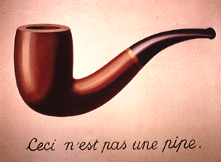
“The most important thing in science is not so much to obtain new facts as to discover new ways of thinking about them.”
Sir William Bragg
Notes:
Renee Magritte

Slide 3
Who are you?
Name
Field/Major
What are your senior design/thesis topics?
What do you want to do when you grow up?
Something unique about you?

Slide 4
Intro Questions
What do you hope to get out of this class?
What do you expect to get out of this class?
How do you know you have gotten it?

Slide 5
Syllabus
2 Topic Presentations (Short 15-20) based on # of students (25%)
1 Self Presentation (Short 15-20) based on # of students (15%)
1 Poster (20 %)
1 Project (30 %)
Class Participation (20 %)
  Presentation Critiques
  Class Activities
  Occasional Reading Assignments

Slide 6
Did you count?
2 Topic Presentations 25%
1 Self Presentation 15%
1 Poster 20 %
1 Project 30 %
Class Participation 20 %
----------------------------------------
110%

Slide 7
Syllabus
Class | Date | Topic/Due | Class | Date | Topic/Due
1 | 8/28/2018 | Introduction | 8 | 10/16/2018 | Cognition – Mental Reps / Final Project Prop
2 | 9/4/2018 | Users/Personas | 9 | 10/23/2018 | Cognition – Problem Solving and Decision Making
3 | 9/11/2018 | Anthropomorphics | 10 | 10/30/2018 | Cognition – Communications
4 | 9/18/2018 | Behavior - Perception | 11 | 11/06/2018 | Social – Teams and Biases
5 | 9/25/2018 | Behavior - Sensation | 12 | 11/13/2018 | Social – Networks and Simulation
6 | 10/02/2018 | Cognition - Memory | 13 | 11/27/2018 | Errors and Error Frameworks
7 | 10/09/2018 | Cognition – Attention / Poster Draft & Project Prop | 14 | 12/04/2018 | Error Modeling / Posters and Final Project Due
* Syllabus may change throughout the course

Slide 8

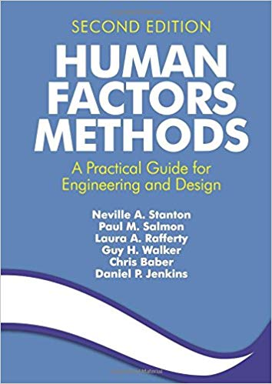
Source Material

Slide 9
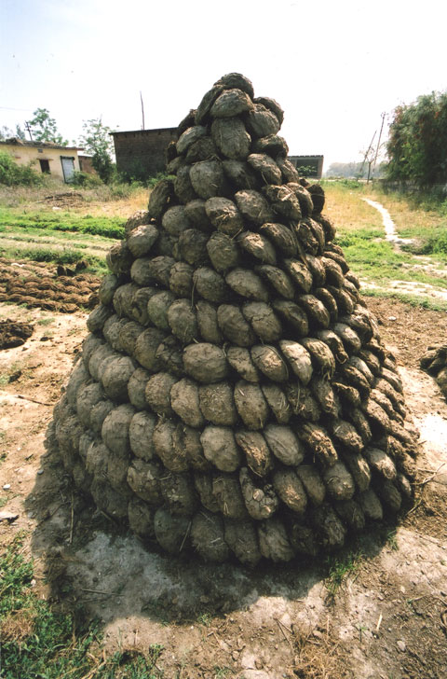
Human Factors is …
Notes:
I’m often asked in my job what do I do?

Slide 10
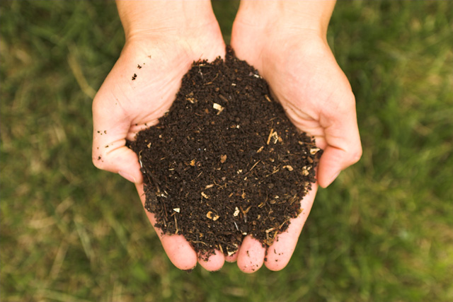

How Should Human Factors be Used?
HFE, like cow manure, should be applied early, in small doses, and repeat as necessary.

Slide 11
Human Factors Applied Correctly

Slide 12

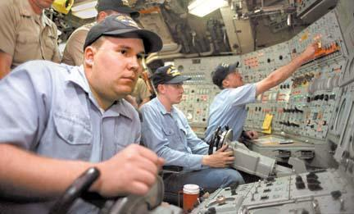


The Human Element
Hu
2009
6.785 x 10⁹
Human
Notes:
Human factors and ergonomics (commonly referred to as Human Factors), is the application of psychological and physiological principles to the (engineering and) design of products, processes, and systems. The goal of human factors is to reduce human error, increase productivity, and enhance safety and comfort with a specific focus on the interaction between the human and the thing of interest.
A "human factor" is a physical or cognitive property of an individual or social behavior specific to humans that may influence the functioning of technological systems. The terms "human factors" and "ergonomics" are essentially synonymous.

Slide 13
Pop Quiz

Slide 14
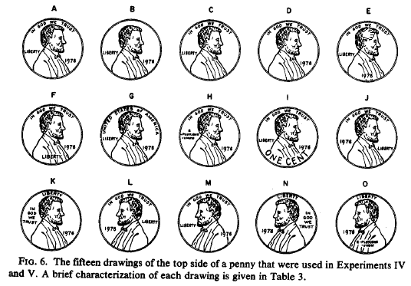
1) Which is a US penny?
Notes:
How many of your fellow students got this right?
We all know what a penny looks like, and can compare it to other coins, but not in any more detail than necessary.

Slide 15
Suppose each card has a number on one side and a letter on the other. Which of these cards are worth turning over if you want to know whether the statement below is false?
…
"If a card has a vowel on one side, then it has an even number on the other side."
A
D
4
7
Notes:
How many of your fellow students got this right?
When Wason and his colleague Johnson-Laird put this type of question to 128 university students, they found that "A and 4" was the most common response (given by 59 people), and "A" was the next most common (given by 42). In other words, students chose the cards capable of confirming the statement rather than disconfirming it. The tendency to seek out confirming evidence is known as a "confirmation bias."

Slide 16
3) Rank Order the Quality of these switch to light mappings based on how fast it takes a user to turn on a given light.
Notes:
How many of your fellow students got this right?

Slide 17
Answers

Slide 18
1) Which is a US penny?
Notes:
We all know what a penny looks like, and can compare it to other coins, but not in any more detail than necessary.
You see similar effects in interfaces, designs and descriptions.

Slide 19
Suppose each card has a number on one side and a letter on the other. Which of these cards are worth turning over if you want to know whether the statement below is false?
…
"If a card has a vowel on one side, then it has an even number on the other side."
check
A
safe
D
safe
4
check
Wason, P. C., & Johnson-Laird, P. N. (1972). Psychology of Reasoning: Structure and Content. Cambridge, MA: Harvard University Press.
7
Notes:
How many of your fellow students got this right?
When Wason and his colleague Johnson-Laird put this type of question to 128 university students, they found that "A and 4" was the most common response (given by 59 people), and "A" was the next most common (given by 42). In other words, students chose the cards capable of confirming the statement rather than disconfirming it. The tendency to seek out confirming evidence is known as a "confirmation bias."

Slide 20
3) Rank Order the Quality of these switch to light mappings based on how fast it takes a user to turn on a given light. a (411 ms), d (469 ms), b and c (each 539 ms). [Payne 1995]
Notes:
How many of your fellow students got this right?
To illustrate why intuitions about people may be incorrect and why it is worth testing actual designs.
The correct ranked order for the buttons in Fig. 1.1 is as follows: (a)
(411 ms3), (d) (469 ms), (b) and (c) (each 539 ms). The lights in D have a
simple rule that users can follow– look to the diagonal. The lights in B and C
have two rules (or at least a more complex rule): if the lights are in the
middle, hit the button below; if the lights are on the end, hit the diagonal
button. The extra conditions, or rules, take extra time to learn and extra time to
perform. They would also lead to more errors.

Slide 21
What is Human Factors Engineering
Fit the Job to the Person
  Equipment Design
  Work Flow/Process Design
  Negotiation of working conditions and rewards
Fit the Person to the Job
  Personnel Selection
  Training and Development
  Occupational Guidance

Slide 22
Human Factors Problems
Humans in systems not behaving as they should be.
A problem which existing methods of design, evaluation, and procurement have somehow not captured, despite in-depth analysis.
Frustratingly resistant to a whole range of purely technical innovations.
Stanton, Neville A., et al. Human factors methods: a practical guide for engineering and design. CRC Press, 2017.
Notes:
Why is it called human factors. In a systems integration problem, would you completely ignore one of the system?

Slide 23
What does it mean to apply human factors?
Research
Extending the work of others
Testing theories of human-system performance
Developing Hypotheses
QUESTION EVERYTHING
Rigorous Data Collection and Analysis
Ensuring Repeatability
Disseminating Findings

Slide 24
What does it mean to apply human factors?
Application
Addressing real-world problems
Seeking the best compromises
Looking to offer cost-effective solutions
Developing demonstrators and prototypes
Analyzing and evaluating the effects of change
Developing benchmarks for best practice
Communicating findings to interested parties
Notes:
Obvious, but not until its been pointed out

Slide 25
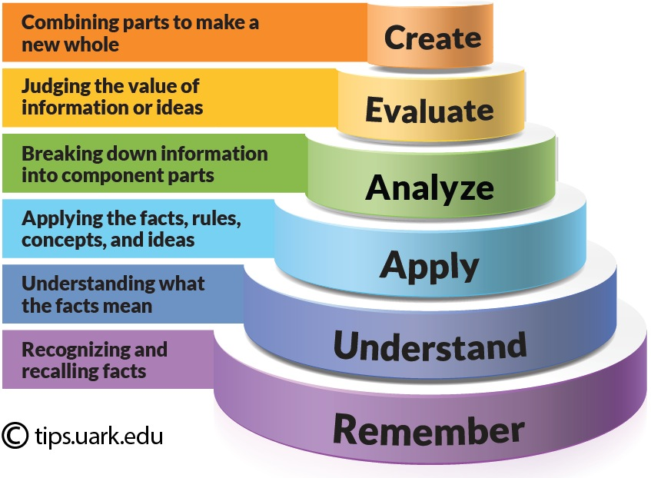
A Framework to think about – Blooms Taxonomy
Tips.uark.edu
Notes:
107

Slide 26
User Centered Design Process
Rosson and Carroll (2002), Usability Engineering: Scenario-Based Development of Human-Computer Interaction

Slide 27
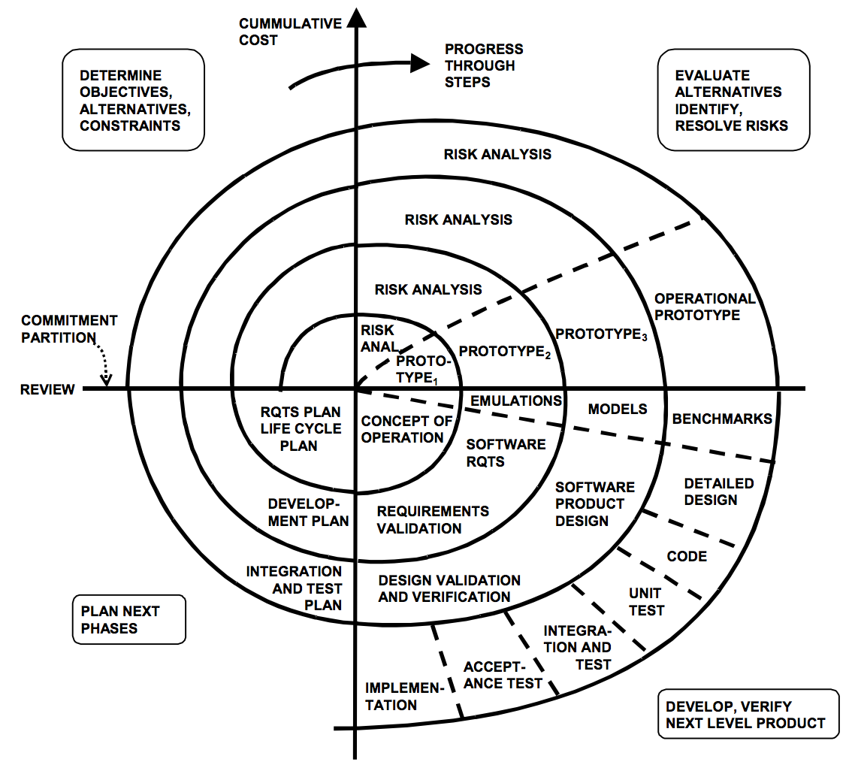
Where and How to Apply Principles

Slide 28
Concepts and Tools
Validating the Methods Selection and Ergonomics Intervention Process (adapted from Stanton and Young, 1999)

Slide 29
Speed Dating
Find your teams
Notes:
Class exercise to determine what groups people want to be in to determine their final projects.

Slide 30
Presentation/Poster Topics
Task Analysis Methods
Cognitive Architectures
Fitts’ Law
Peter Principle
Signal Detection Theory
VARK Learning
Maslov’s Hierarchy
Power Law of Learning
Cynefin Framework
Cognitive Task Analysis
Team Assessment Methods
Operational Sequence Diagrams
Sensory Thresholds and Just Noticeable Difference
Human Error Assessment
Notes:
Over the class students will present, here are example presentation topics that students may choose from.

Slide 31
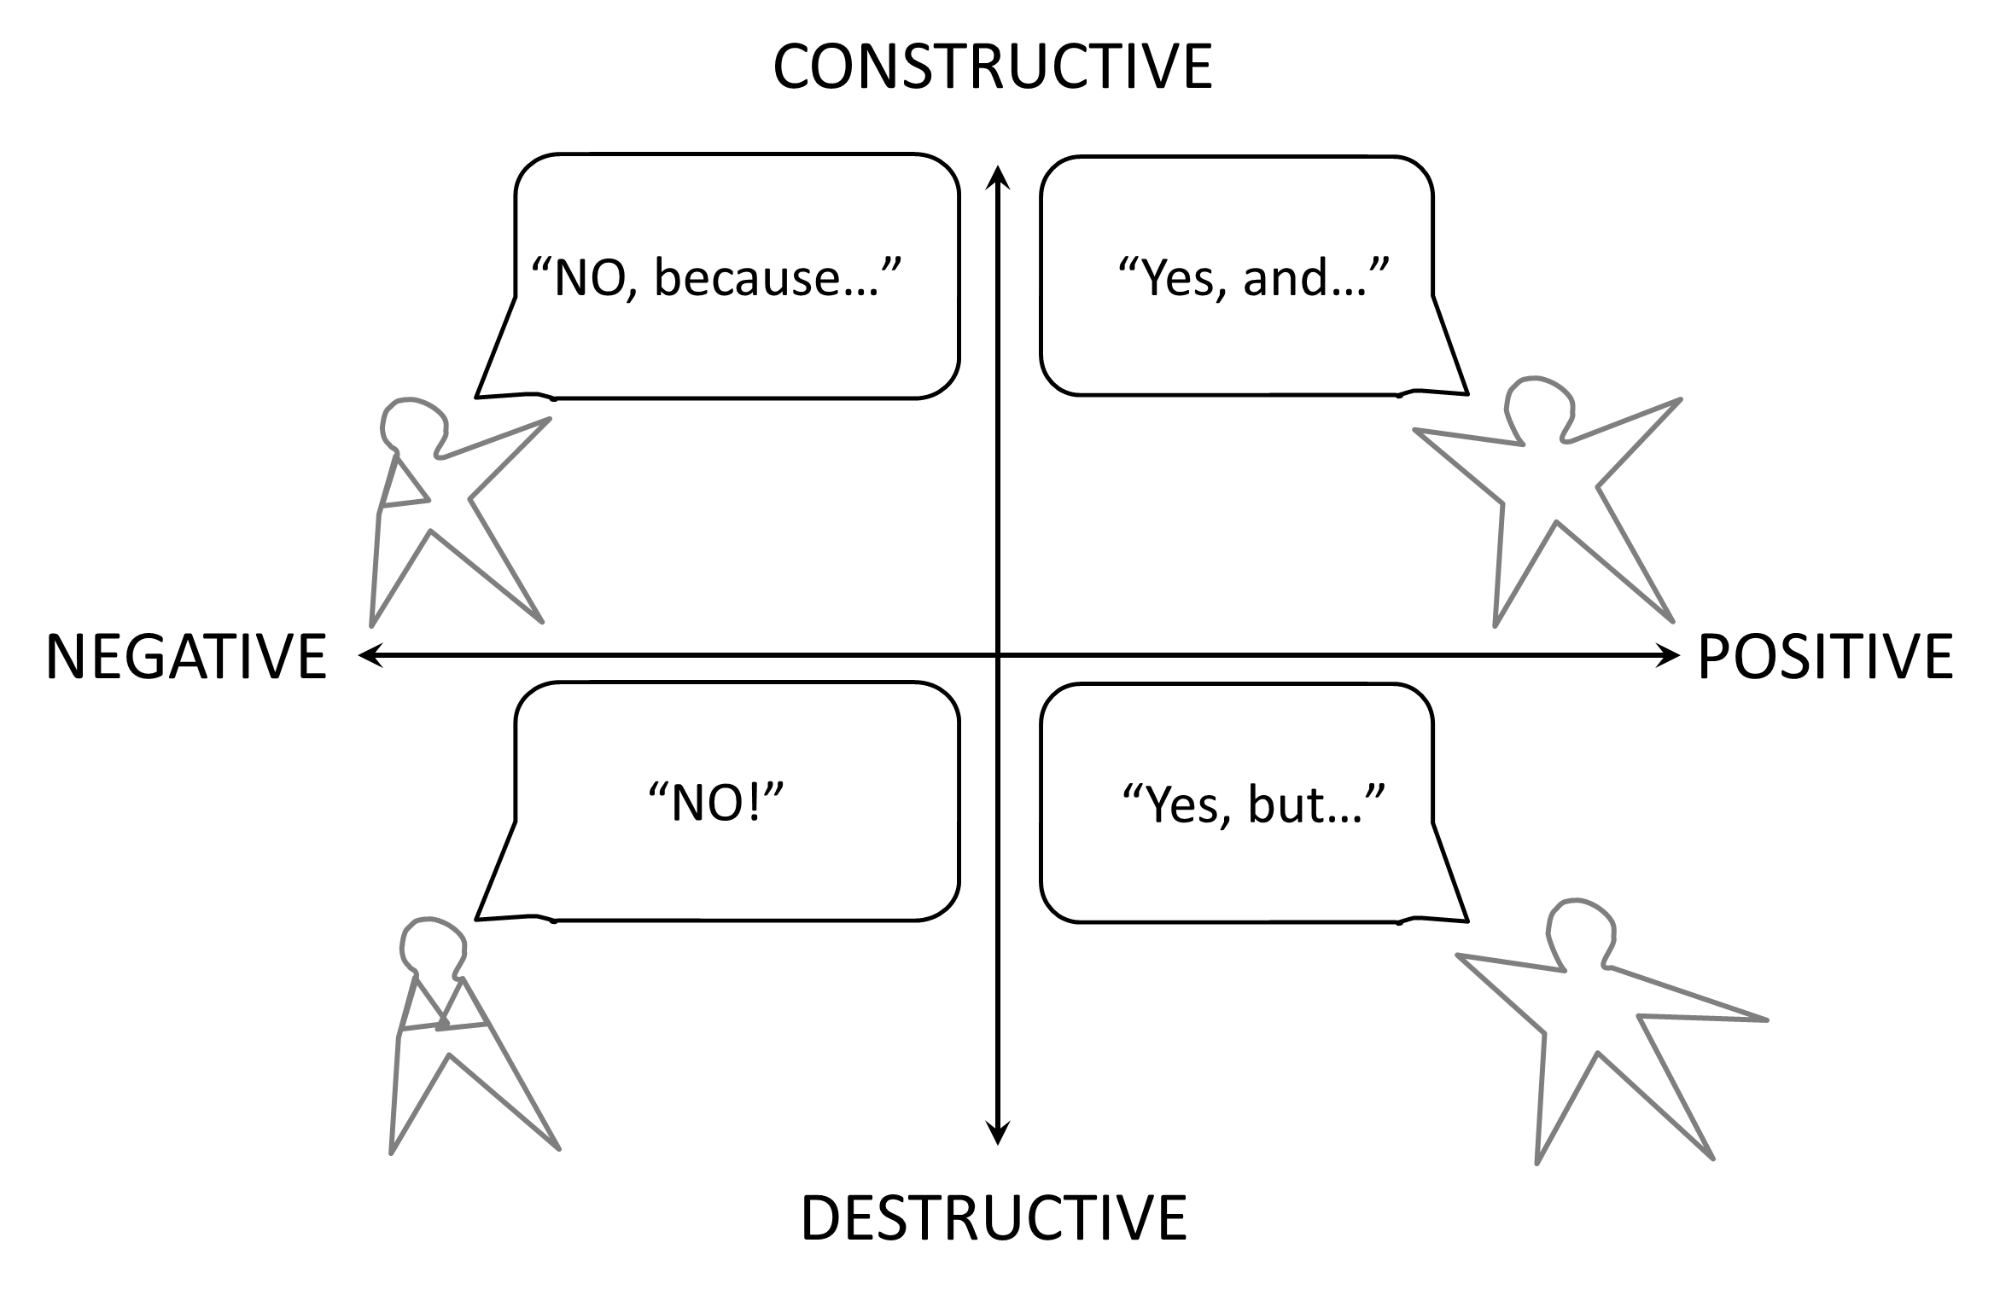
User Centered Design:
Forms of Communication

Slide 32
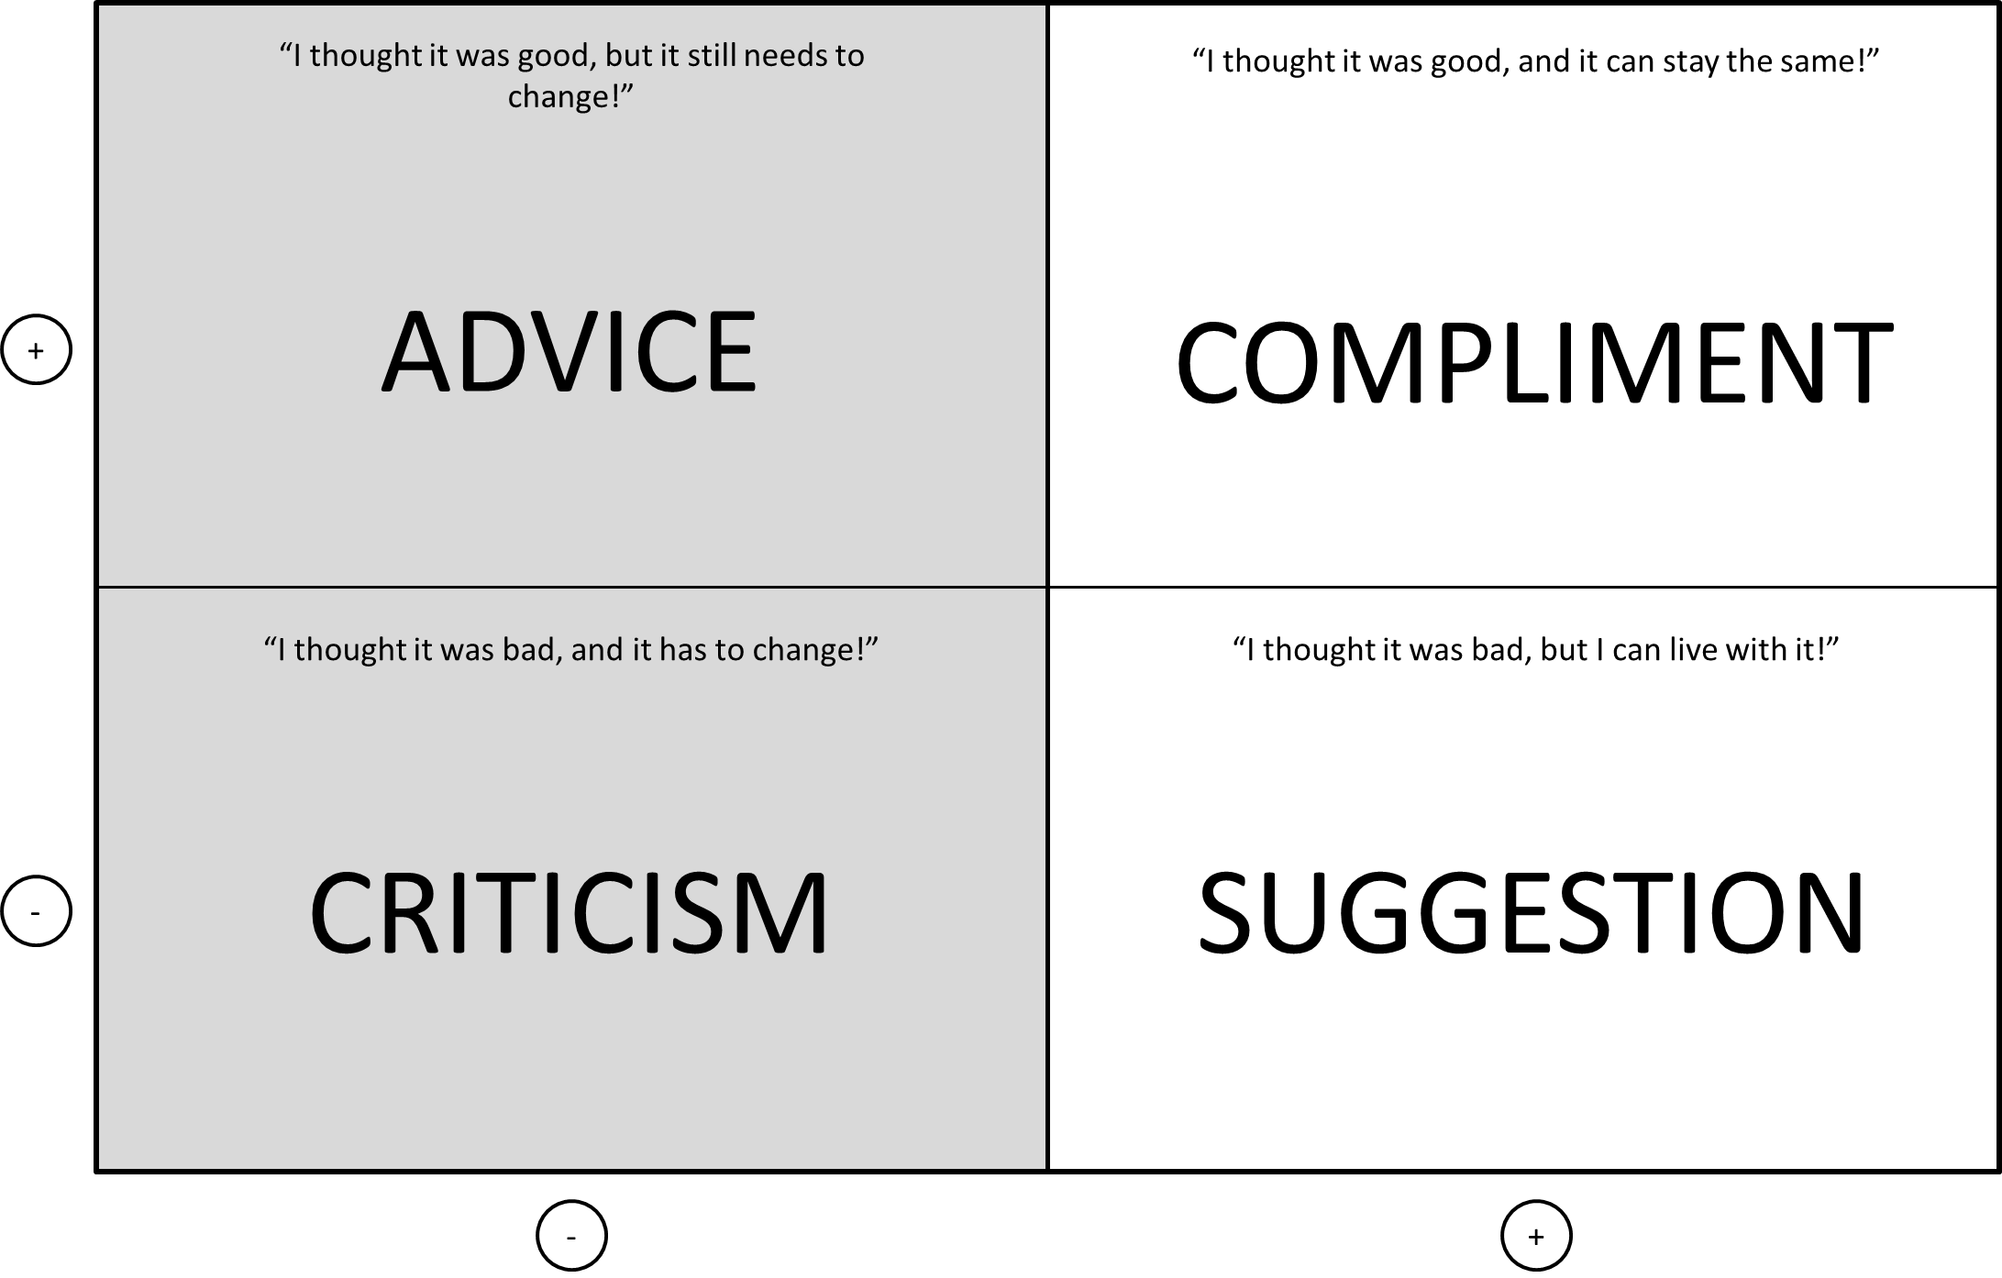
User Centered Design:
Forms of Communication

Slide 33
Resource Planning:
Time Management Framework
+
Important, but not urgent
Urgent and important
DECIDE WHEN YOU WILL DO IT
DO IT IMMEDIATELY
IMPORTANT
Not important, not urgent
Urgent, but not Important
DO IT LATER
DELEGATE TO SOMEBODY ELSE
-
-
URGENT
+

Slide 34
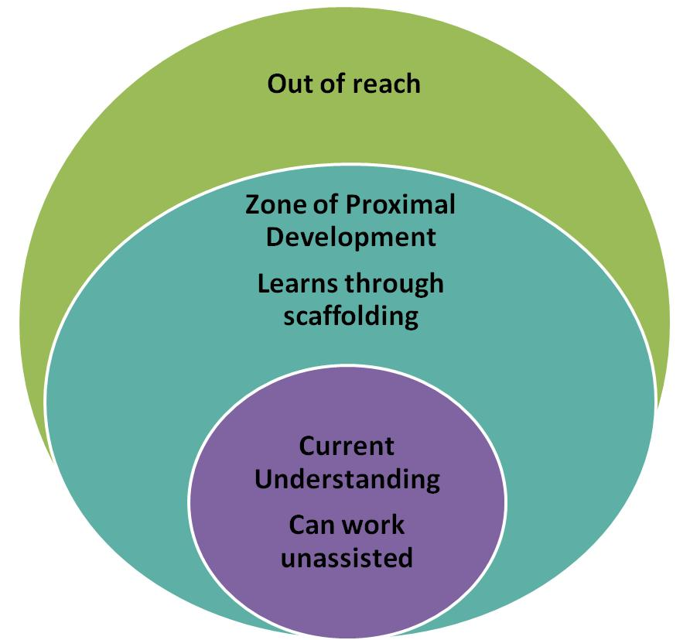
User Centered Design:
Form of Thought
Zone of Proximal Development
Scaffolding is structuring the position or concept in such a way that it can be taught and understood.
ZPD implies that some foundational knowledge must already be present to reach higher levels.
Associating Blooms Taxonomy
  Purple is the evaluate level.
  Turquoise is the understand level.
  Scaffolding is generating the structure necessary for remembering.

Slide 35

Bonus Content – Learning with Allegory

Slide 36
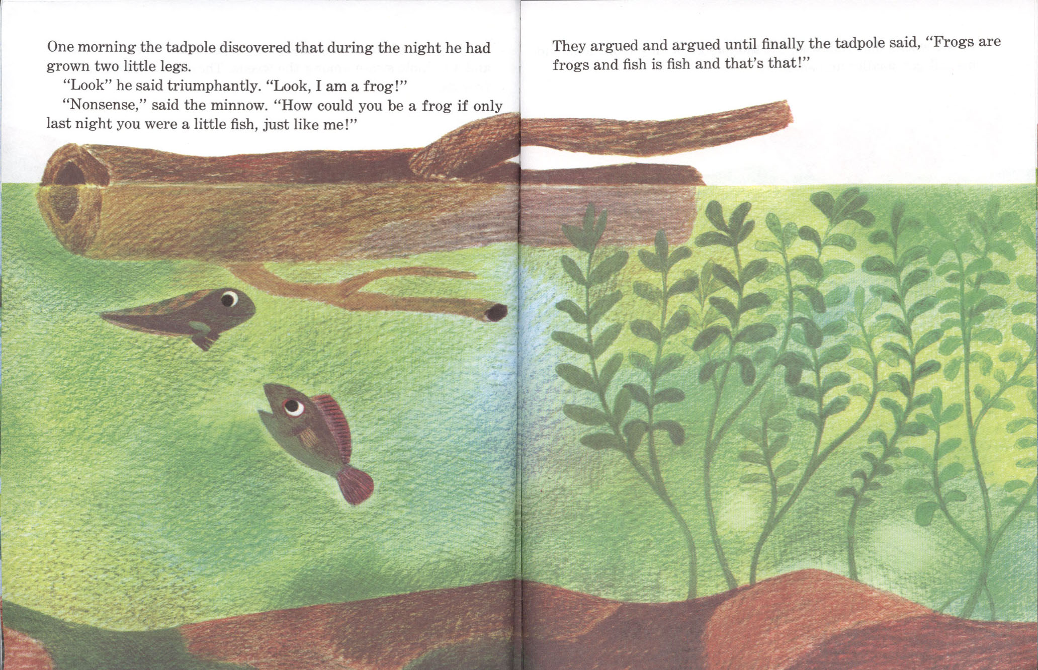

Slide 37


Slide 38


Slide 39
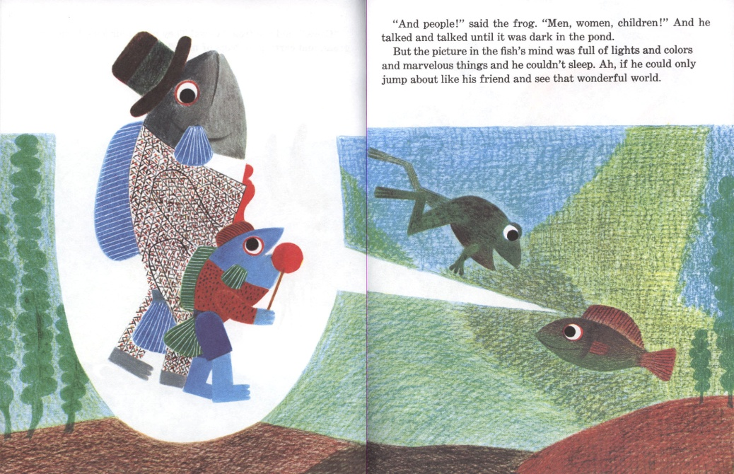



Slide 40


Slide 41
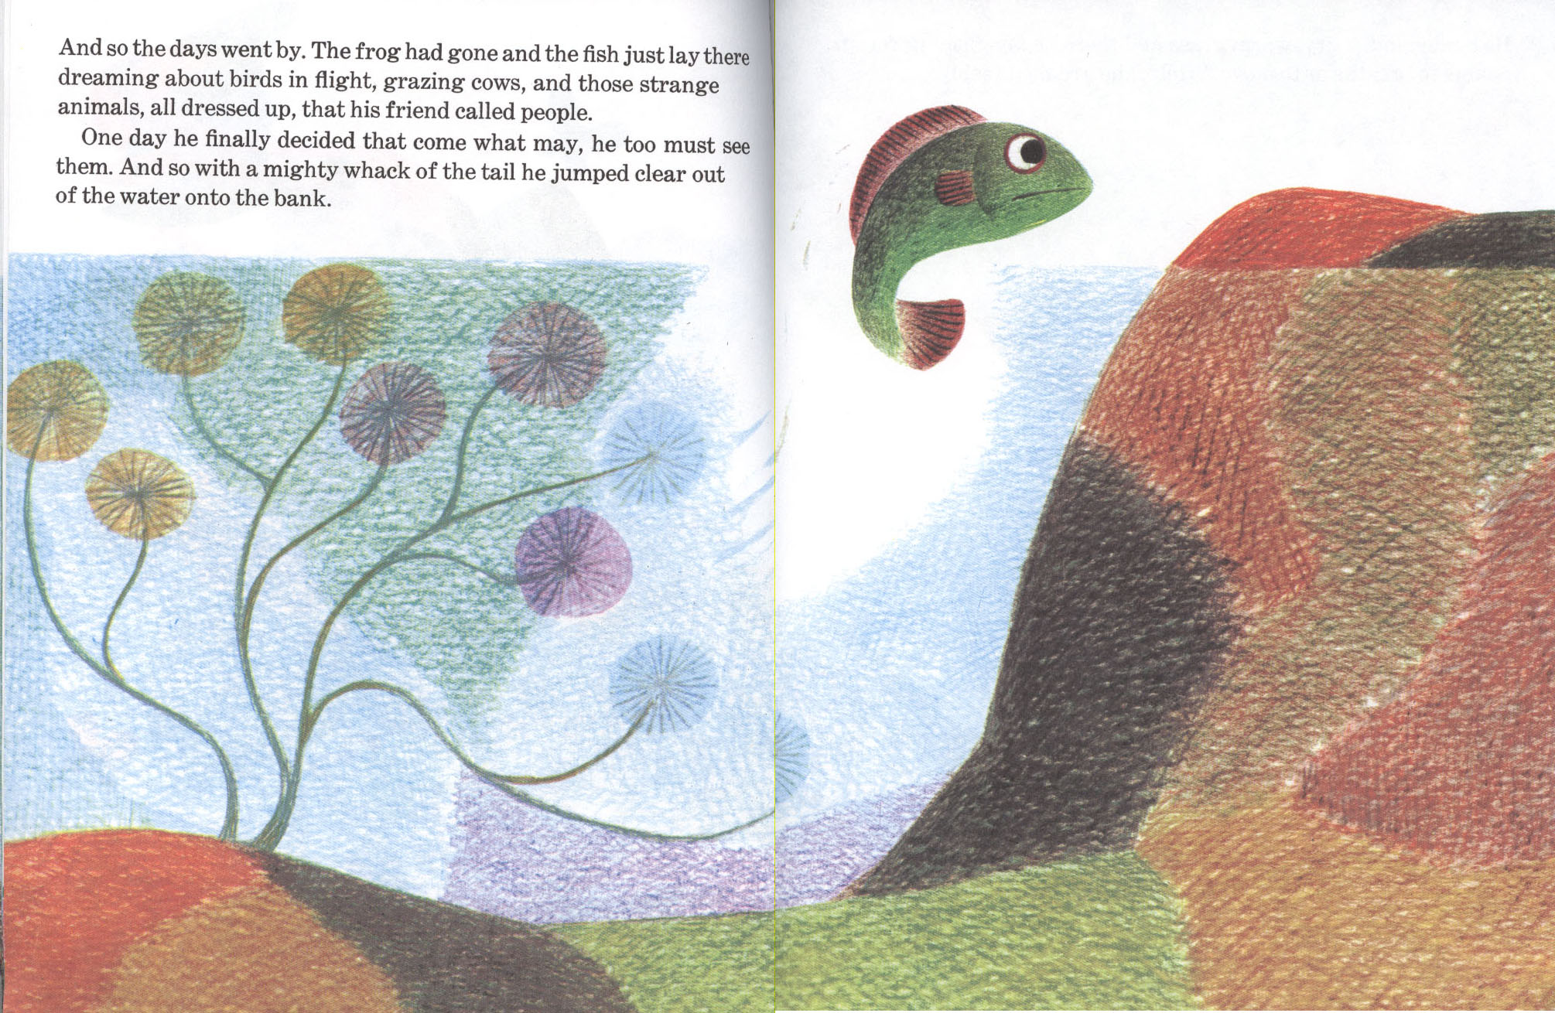

Slide 42


Slide 43
